Slide 1
SD5959 Psychology of Design II Class 2E: COMMUNICATIONS NETWORKS
School of Design
The Polytechnic University of Hong Kong

Slide 2
IMPORTANT
Please sit with the members
of your final group project

Slide 3
Network Types
Phil
Joe
Joe
Joe
Sara
Tony
Sara
Tony
Kate
Sara
Sara
Kate
Kate
Phil
Phil
Tony
Phil
Joe

Slide 4
Circle
Joe
In a circle network, information flows in a circular direction rather than vertical direction. A can communicate simultaneously with two persons, B and C but to communicate with D, he has to pass the messages through B or C and E. All five persons cannot directly communicate with each other.
In a circle network, the lowest level worker can communicate with the top manager. (A could be the top manager and C could be the lowest level worker). Any formal claims of command is, thus, not respected in this network.
Tony
Sara
Phil

Slide 5
Wheel
Joe
In a wheel network, all messages flow through A, who is at the centre of the wheel. He communicates with other members of the group, while members cannot communicate with each other. The superior communicates the information to subordination to subordinates while the subordinates do not communicate amongst themselves.
This communication network is found in highly formal organization structures where task-oriented approach to leadership is preferred to employee-oriented approach.
Tony
Kate
Sara
Phil

Slide 6
Star
Joe
In a star network, all members are able to communicate with each other freely and regularly. This network type follows mostly informal channels of communication and can provide maximum satisfaction to members. Information can flows very fast, though there may be problem of coordination.
This communication network is found in highly informal organization structures where a goal-oriented approach to leadership is preferred to a task-oriented or employee-oriented approach. This is usually also an “official” path of communication where information flows ‘through proper channel’ between superiors and subordinates, or to external parties.
Sara
Kate
Tony
Phil

Slide 7
Chain
Phil
In a chain network, communications follows a formal chain of command where information flows vertically upwards or downwards. Superiors and subordinates communicate with each other through vertical chain of command, both upwards and downwards.
Information distortion is not likely to take place but communication system of this type can be time consuming, because the cost of relaying information occurs at every link of the chain.
Sara
Kate
Joe

Slide 8
How Organizations Work
Organizations are problem-solving machines
Organizations use goal-decomposition to function
Organizations Operate at the following levels
Mission
Strategy
Goals
Targets
Actions

Slide 9
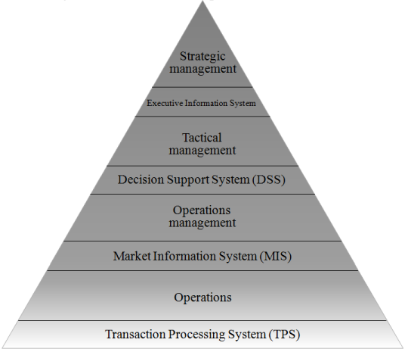
How Companies Are Organized

Slide 10
Organizational Function Mapping
Mission
Strategy
Goals
Targets
Actions

Slide 11
Probabilistic models Ill-defined problems Unstructured decisions
Strategic
management
Executive Information System
Tactical
management
Decision Support System (DSS)
Operations
management
Market Information System (MIS)
Operations
Transaction Processing System (TPS)
Deterministic models Well-defined problems Structured decisions

Slide 12
Plotting the S-curve onto
organizational structure
Maturity of ideas
Acceleration of ideas
Infancy of ideas

Slide 13
Entropy
Crazy ideas
The new
vision
Down
to earth ideas
Flip it!

Slide 14
Probabilistic models Ill-defined problems Unstructured decisions
Entropy
Crazy ideas
Creative problem solving
Opportunity seeking
Creativity - divergence
Vision of novel contexts
The new
vision
Serendipity
Strategic
management
Down
to earth ideas
Executive Information System
Tactical
management
Analogy
Disruption
Decision Support System (DSS)
Operations
management
Learned adaptation, understanding of contexts
Intelligence - convergence
Survival focus
Rational problem solving
Market Information System (MIS)
Continuity
Operations
Transaction Processing System (TPS)
Deterministic models Well-defined problems Structured decisions

Slide 15
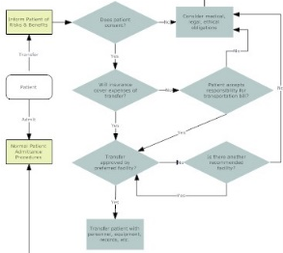
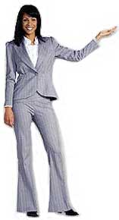
The role of communication networks
Probabilistic models Ill-defined problems Unstructured decisions
Why didn’t anyone inform me?

☞
Strategic
management
Executive Information System
Too deterministic
Tactical
management
Problem Space
Decision Support System (DSS)
+1
+1
+1
+1
Operations
management
Too probabilistic
1
Market Information System (MIS)
Operations
Transaction Processing System (TPS)
Deterministic models Well-defined problems Structured decisions
http://www.jnj.com/images/content/content_images/2003AnnualReport/board/board_2.jpg
http://www.assistedlivingstore.com/gown.jpg

Slide 16
The role of communication networks
Why don’t I know what is happening downstairs?
Strategic
management
Phil
Chain
Phil
Executive Information System
Sara
Where is Sara?
Tactical
management
?
Sara
Kate
Decision Support System (DSS)
Why don’t I know what is happening upstairs?
Operations
management
Joe
Kate
Market Information System (MIS)
Operations
Joe
Transaction Processing System (TPS)
Deterministic models Well-defined problems Structured decisions
http://www.jnj.com/images/content/content_images/2003AnnualReport/board/board_2.jpg
http://www.assistedlivingstore.com/gown.jpg

Slide 17
The role of communication networks
I know everything that happens downstairs
Strategic
management
Phil
Wheel
Phil
Executive Information System
Tony
Kate
Sara
Tactical
management
I always tell Tony and Sara too
Joe
Decision Support System (DSS)
Operations
management
I know everything that happens upstairs
Kate
Market Information System (MIS)
Operations
Joe
Transaction Processing System (TPS)
Deterministic models Well-defined problems Structured decisions
http://www.jnj.com/images/content/content_images/2003AnnualReport/board/board_2.jpg
http://www.assistedlivingstore.com/gown.jpg
http://www.jnj.com/images/content/content_images/2003AnnualReport/board/board_2.jpg
http://www.assistedlivingstore.com/gown.jpg

Slide 18
The role of communication networks
I know nothing of what happens downstairs
Strategic
management
Phil
Wheel
Phil
Executive Information System
Tony
Kate
Sara
Tactical
management
By the way, I got another job offer…
Joe
Decision Support System (DSS)
Operations
management
I know nothing of what happens upstairs
Kate
Market Information System (MIS)
Operations
Joe
Transaction Processing System (TPS)
Deterministic models Well-defined problems Structured decisions
http://www.jnj.com/images/content/content_images/2003AnnualReport/board/board_2.jpg
http://www.assistedlivingstore.com/gown.jpg
http://www.jnj.com/images/content/content_images/2003AnnualReport/board/board_2.jpg
http://www.assistedlivingstore.com/gown.jpg

Slide 19
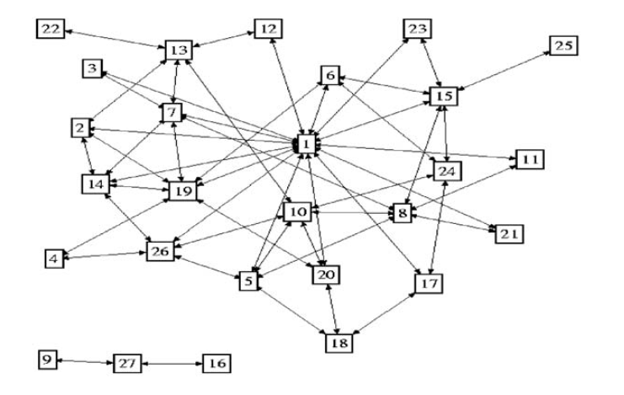
Where should a creative leader position him/herself?
Top dog!
Traditional leadership:
High centrality
Many communication lines within group
No 1 position
Creative leadership:
High bridging
Many communication lines to other groups
No 5 position or 26 or… where they can be linkers
http://i0.wp.com/www.trac7.org/files/2014/01/140007492.jpg
Look for the person who is most segregated from the mean (group) development but has the largest access to the most differentiated information (which may be provided by others). That is the one to come up with the next breakthrough idea. This radius of action may be widened when people most separated from the current developments do this in co-creation
Start bridging

Slide 20
Case Studies

Slide 21
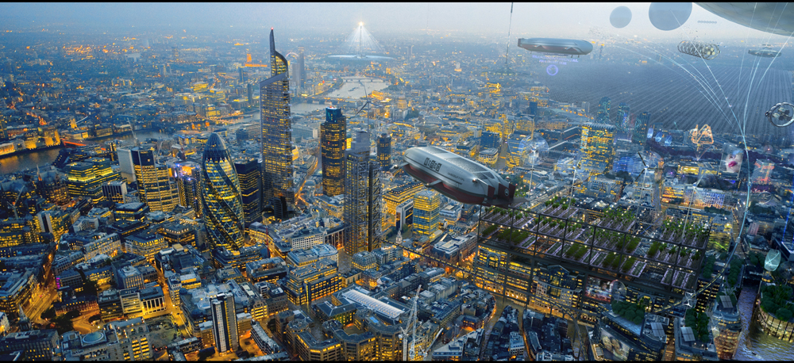
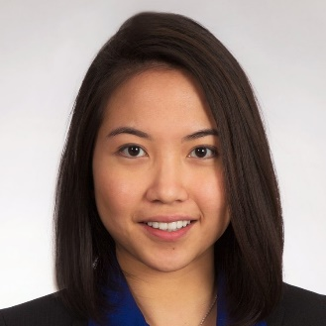
Example Communications Problems

Slide 22
Phil
Joe
Communication
designer Amy
Project is divided into three subprojects. I am working within one of those sub-projects. The project team has a project leader for each sub-project. There is a sub-project meeting every week.
Periodically, the three project leaders meet with the client. Problem communication. Despite the weekly client consultation, things are not done or done differently.
Causes unnecessary confusion. Straightening out of what goes wrong takes a lot of time and energy, and is bad for planning.
Tony
Kate
Sara
Sara
Kate
Joe
Wheel
Star
Tony
Phil
Joe
Circle
Chain
Phil
http://i.dailymail.co.uk/i/pix/2017/06/21/08/41941D9C00000578-4624316-image-a-10_1498028665880.jpg
Tony
Sara
Sara
Phil
Kate
And why doesn’t anyone fill Amy in?
Joe
Amy

Slide 23
Not taken seriously! (communication from the inside out)
Patronizing! (communication from the outside in)
Joe
Client
Paula (Chi Nan), service designer
Domain: Adaptations and extensions to a product-service system with a fixed project team with quite different characters. Nature of the problem: The block-chain developers in particular I had to approach ‘cautiously.’
Occasionally, they felt too much patronized on the one hand (I worked designs out in too much detail); on the other hand they felt they were not heard (they came up with ideas that did not always apply and therefore those ideas were not worked out).
There was also difficulty with the flexible and dynamic work environment and customer wishes. This caused tension between the project members. Involved: FO staff, developers, testers, and PR officers
Tony
Developers
circle
Sara
Who receives?
Much comm!
Phil
Paula
Fixed
project team
https://ak9.picdn.net/shutterstock/videos/31710499/thumb/1.jpg
Who receives?
Not Paula!
Joe
Phil
Joe
Tony
Sara
Tony
Kate
Sara
Sara
Kate
Phil
Joe
Tony
Phil
Changes

Slide 24
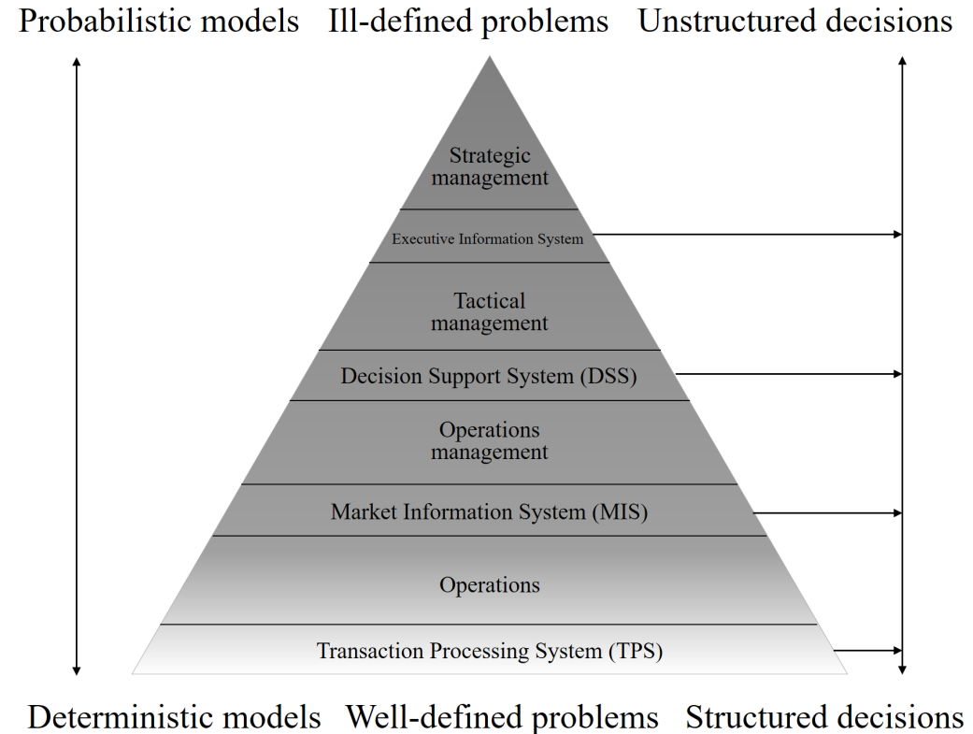
Content, purpose, vision, mission, change
Joyce (Meifeng),
urban designer
In 2017, I was briefly involved as an urban designer at e-Government, Basic Registration Addresses and Buildings under the responsibility of the Housing Ministry and Land Registry.
I started urban planning with analysis and design. Attempted to draft an Urban Vision document. Main bottlenecks:
1. Positioning: Current situation, problem definition, added value of the design unclear
2. Who are stakeholders and what is their role? How to determine functionality and priority?
3. Previous infrastructure decisions to divide area into separate centers and the provision of buildings.
You will encounter this with more, if not all, basic planning projects. The question is whether this was a correct infra-structure and architectural choice?
Leadership
Phil
Sara
Format, process, rules, regulations, procedure, status quo
Kate
https://static1.squarespace.com/static/5744a9e762cd94df457ddd8c/584e0e83b8a79bf389e98d09/584e0e84b8a79bf389e98d0a/1481510680426/Ada.jpg
Management
Joyce
Customer
satisfaction
Managerial, a process may be in control, whereas it is derailed purpose-wise
Efficiency
Effectiveness

Slide 25
Questions?
Discussion

Slide 26
Thank You

