Slide 1
SD5959
Psychology of Design II
Class 2C:
THE INNOVATION CURVE
School of Design
The Polytechnic University of Hong Kong

Slide 2
IMPORTANT
Please sit with the members
of your final group project

Slide 3
The Diffusion of Innovation
In 1962, Everett Rogers published Diffusion of Innovations (ISBN 978-0-7432-5823-4 ), which outlined how change is adopted by people
He identified 5 stages that fell along a normal distribution, or “Bell Curve”
When a normal distribution is projected as an accumulation, it becomes an “S-Curve”

Slide 4
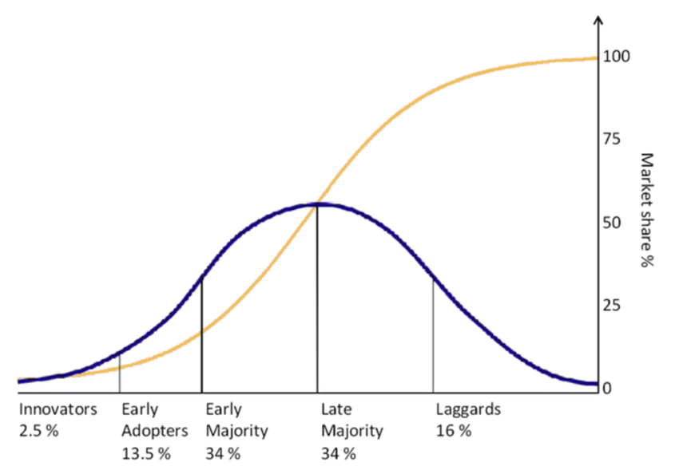
“Bell Curve” vs. “S Curve”

Slide 5
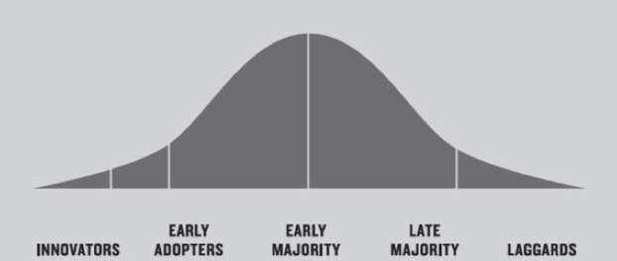
Rogers’ Diffusion of Innovation
https://medium.com/the-political-informer/the-rogers-adoption-curve-how-you-spread-new-ideas-throughout-culture-d848462fcd24

Slide 6

Innovators
2.5%
https://medium.com/the-political-informer/the-rogers-adoption-curve-how-you-spread-new-ideas-throughout-culture-d848462fcd24
These individuals are willing to take risks, have high wealth and social status, have the greatest access to scientific sources and interaction with other innovators. Their high risk tolerance allows them to adopt technologies that may ultimately fail. Their financial resources help absorb these failures. They exercise strong opinion leadership.

Slide 7

Early Adopters
13.5%
https://medium.com/the-political-informer/the-rogers-adoption-curve-how-you-spread-new-ideas-throughout-culture-d848462fcd24
These individuals have high social status, financial liquidity, advanced education and are more socially forward than late adopters. They are more discretionary in adoption choices than innovators. They use judicious choice of adoption to help them maintain a central communication position but they have the highest degree of opinion leadership among the adopter categories.

Slide 8

Early Majority
34%
https://medium.com/the-political-informer/the-rogers-adoption-curve-how-you-spread-new-ideas-throughout-culture-d848462fcd24
These individuals adopt an innovation after a varying degree of time that is significantly longer than the innovators and early adopters. Early Majority have above average social status, contact with early adopters and seldom hold positions of opinion leadership in a system

Slide 9

Late Majority
34%
https://medium.com/the-political-informer/the-rogers-adoption-curve-how-you-spread-new-ideas-throughout-culture-d848462fcd24
These individuals adopt an innovation later than the average participant. They approach innovation with a high degree of skepticism, have below average social status, little financial liquidity, are only in contact with others in late majority and early majority and exercise little opinion leadership.

Slide 10

Laggards
16%
https://medium.com/the-political-informer/the-rogers-adoption-curve-how-you-spread-new-ideas-throughout-culture-d848462fcd24
These individuals adopt innovations late. They have an active aversion to change and its agents. They are typically traditional, conservative, of lower social status and wealth and older. They tend to only be in contact with family and close friends. They exercise zero opinion leadership.

Slide 11
Questions?
Discussion

Slide 12
Thank You

