Slide 1
SD5959
Psychology of Design II
Class 2A:
PERSONALITY
School of Design
The Polytechnic University of Hong Kong

Slide 2
IMPORTANT
Please sit with the members
of your final group project

Slide 3
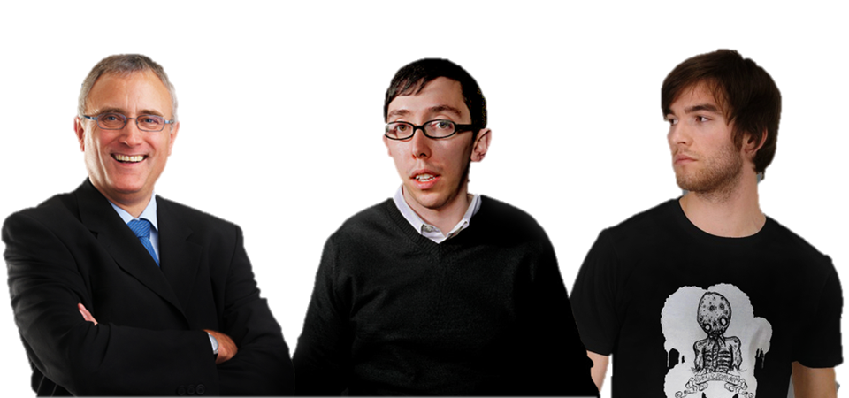
Identity
I’m the CEO
I’m the
Creative Director
I’m the Chief Technologist
How To Get Them to Hear Each Other?

Slide 4
Orientation
RULES!
VALUES!
CODE!
How To Get Them To Understand Each Other?

Slide 5
Priorities
Where are we in that project?
Is this the right project?
LOGIC!
How To Get Them to Trust Each Other?

Slide 6

How About a Tool?

Slide 7
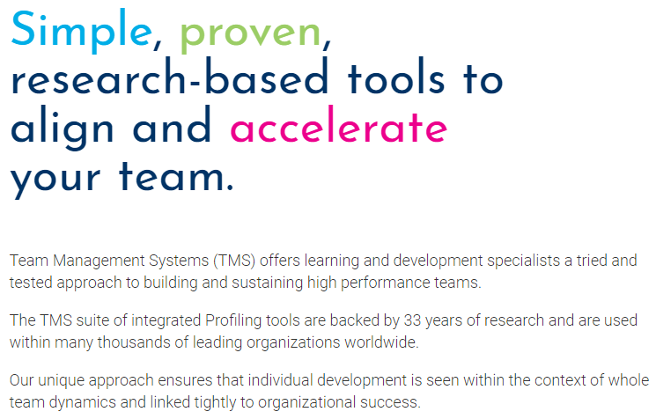
The TMS

Slide 8

The TMS Value Mandella
Compliance
Needing to work with an agreed set of rules and procedures
vs.
Empowerment
Requiring autonomy and needing personal input
Margerison-McCann Team Management Systems (TMS)

Slide 9
The TMS Value Mandella
Conformity
Avoiding extreme action and conforming to external expectations
vs.
Independence
Valuing personal creativity and independence
Margerison-McCann Team Management Systems (TMS)

Slide 10
The TMS Value Mandella
Collectivism
Focusing more on the group than the individual
vs.
Individualism
Focusing solely and entirely on personal drivers
Margerison-McCann Team Management Systems (TMS)

Slide 11
The TMS Value Mandella
Equality
Focusing on both the group and organizational freedom
vs.
Authority
Wanting to work within clearly defined power systems
Margerison-McCann Team Management Systems (TMS)

Slide 12
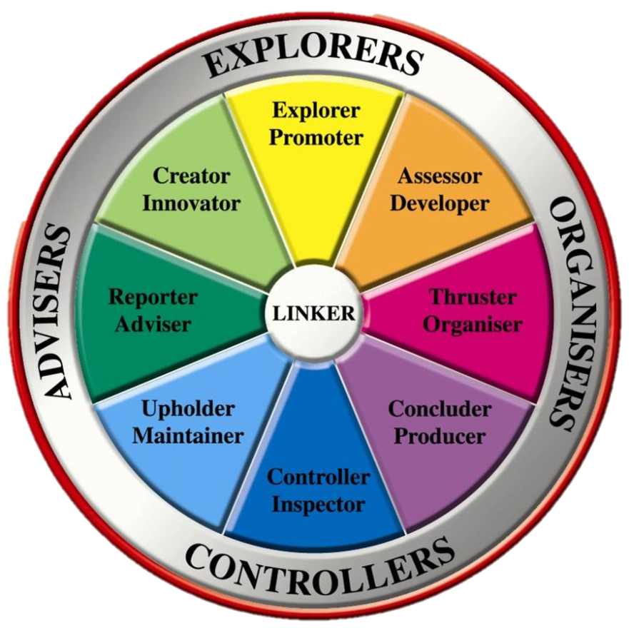
The 8 TMS Personalities

Slide 13
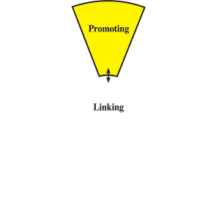
The Explorer / Promoter
https://www.leader-values.com/article.php?aid=709

Slide 14
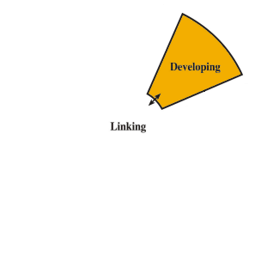
The Assessor / Developer
https://www.leader-values.com/article.php?aid=709

Slide 15
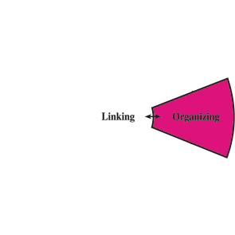
The Thruster / Organizer
https://www.leader-values.com/article.php?aid=709

Slide 16
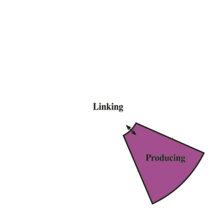
The Concluder / Producer
https://www.leader-values.com/article.php?aid=709

Slide 17
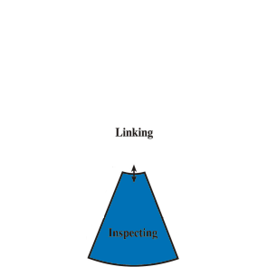
The Controller / Inspector
https://www.leader-values.com/article.php?aid=709

Slide 18
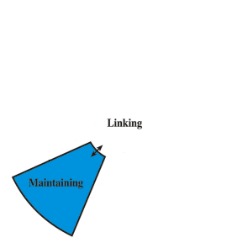
The Upholder / Maintainer
https://www.leader-values.com/article.php?aid=709

Slide 19
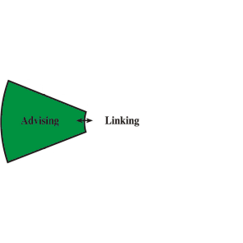
The Reporter / Advisor
https://www.leader-values.com/article.php?aid=709

Slide 20
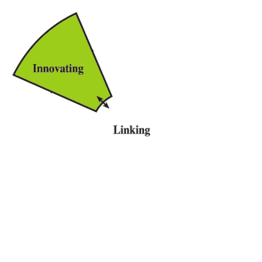
The Creator / Innovator
https://www.leader-values.com/article.php?aid=709

Slide 21
We Are All So Different
YET
We Are All So Similar
Like With DNA, TMS Results Show
Us That Small Differences Can
Make A Big Difference

Slide 22
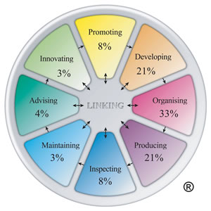
Case Study 1
This person has a strong preference for organizing, developing and producing and is less likely to be comfortable moving outside their comfort zone

Slide 23
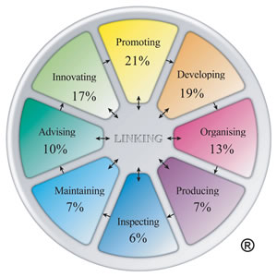
Case Study 2
This person is likely to enjoy working in many different areas and show more versatility

Slide 24
Want To Know More?
www.teammanagementsystems.com

Slide 25
Questions?
Discussion

Slide 26
Thank You

