Slide 1
SD5953
Successful Project Management
FINAL PROJECT PLAN INSTRUCTIONS
School of Design
The Polytechnic University of Hong Kong

Slide 2
IMPORTANT
Please sit with the members
of your final group project

Slide 3
FINAL Project Plan - Instructions
The requirements for the FINAL Project Plan were outlined in 1st CLASS ORIENTATION, which happened on the first day of class
This presentation is an extract of that one, with all extra information removed, but nothing else changed except a desired length indication, because some reports had a lot of images in them, but little text/depth/analysis.

Slide 4
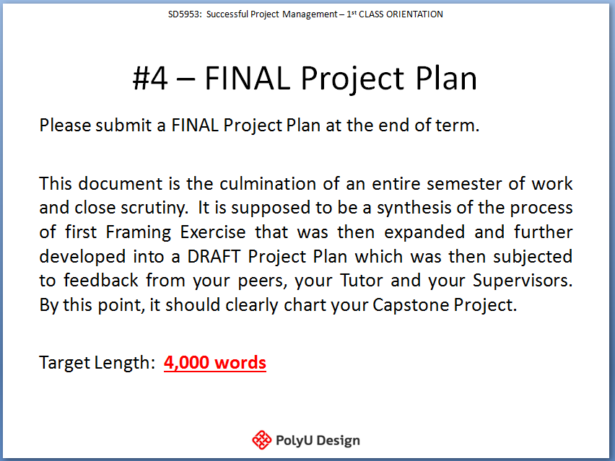
Original Slide

Slide 5
#4 – FINAL Project Plan
Please submit your FINAL Project Plan at the end of term. It is the culmination of an entire semester of scrutiny.
It is supposed to be a synthesis of the Framing Exercise further developed into a DRAFT Project Plan that was presented for feedback to your peers, Supervisors and outside parties. It should chart and measure your Summer Capstone Project.

Slide 6
#4 – FINAL Project Plan
Your FINAL Project plan must be at least this long:
~4,000 words

Slide 7
#4 - Final Project Plan (Breakdown)
Part 01: Scope Definition
All projects begin with a project scope that incorporates clear measures of success (MOS).

Slide 8
#4 - Final Project Plan (Breakdown)
Part 02: Project High Level & Sub Achievements
To become actionable, the Measure of Success (MOS) must be broken down into blocks called high-level achievements (HLA) that are then divided into sub achievements (SA).
This helps to uncover actionable work items and enables the Project Manager to see where additional detail or refinement is required. It is here where project risks are often first identified.

Slide 9
#4 - Final Project Plan (Breakdown)
Part 03: Project Assumptions, Risk, and Charter
All project goals and plans feature assumptions, which introduce risk. Risk management is a big part of Project Management.
Major and minor risks need to be carefully considered when crafting the project plan. These, along with the Scope, HLAs & SAs, combine to form your formal project charter.

Slide 10
#4 - Final Project Plan (Breakdown)
Part 04: Project Work Breakdown Structure
The most granular level of a project is a listing of the actual tasks to be performed, broken down to the point where they cannot be further reduced.
The listing of these tasks is called the project Work Breakdown Structure (WBS).

Slide 11
#4 - Final Project Plan (Breakdown)
Part 05: Project Predecessors
In Project Management it is important to determine what needs to occur before something else.
The definition of predecessors achieves this by figuring out the order in which tasks need to happen.

Slide 12
#4 - Final Project Plan (Breakdown)
Part 06: Project Duration Estimates and Resources
Now you have a basic project structure. It needs a sense of time. Each of the defined tasks now needs to have duration attached.
Estimating durations is both a skill and an art and an iterative learning process that requires practice.

Slide 13
#4 - Final Project Plan (Breakdown)
Part 07: Critical Path Analysis
The critical path is the shortest timeline possible for your project. It is composed of the chain of tasks that, if affected in terms of their duration, will lengthen the overall project.
These are the tasks to be most carefully watched.

Slide 14
#4 - Final Project Plan (Breakdown)
Part 08: Project Tracking and Status Reporting
Things cannot be properly managed if they are not measured.
Monitoring and progress reporting is a critical aspect of Project Management, especially within in a large corporate setting or when dealing with an even moderately complex project.

Slide 15
Final Project Plan Due Date
The deadline for submission of the Final Project Plan is:
MONDAY, April 29 2019 @ 23h00

Slide 16
QUESTIONS?

Slide 17
THANK YOU

