Slide 1
SD5953
Successful Project Management
SELECTING THE RIGHT PM METHOD
School of Design
The Polytechnic University of Hong Kong

Slide 2
IMPORTANT
Please sit with the members
of your final group project

Slide 3
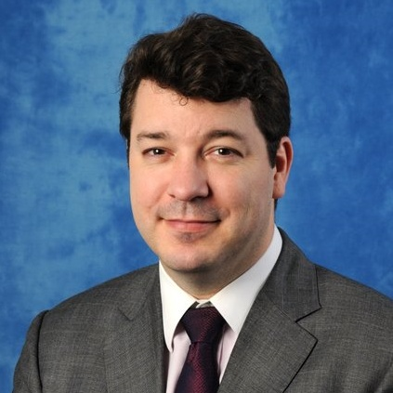
Graham Leach, Instructor
www.graham-leach.com
polyusd5953@gmail.com

Slide 4
SELECTING THE RIGHT PM METHOD
Choosing the Perfect
Tool for the Job

Slide 5
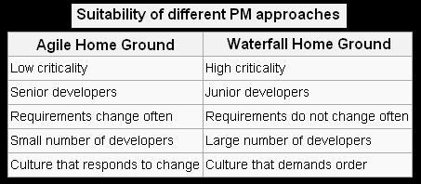
Your Options

Slide 6
QUESTIONS?

Slide 7
THANK YOU

