Slide 1
SD5953
Successful Project Management
AGILE SOFTWARE DEVELOPMENT
School of Design
The Polytechnic University of Hong Kong

Slide 2
IMPORTANT
Please sit with the members
of your final group project

Slide 3

Graham Leach, Instructor
www.graham-leach.com
polyusd5953@gmail.com

Slide 4
AGILE
A BRAVE NEW WORLD

Slide 5
Where did AGILE Come From?
Agile oriented development ideas have been around for a really long time. Some say as early as the 1950’s.
But Agile ideas really accelerated when Object Oriented Programming became popular in the 80’s. OOP required a total re-think of how we “do” computer programming.
Once Rapid Application Development (RAD) and the Rational Unified Process (RUP) emerged, the field became formalized.
http://en.wikipedia.org/wiki/Agile_software_development

Slide 6
Recent Developments For AGILE
In 2001 things really started to happen in the Agile community. A group of IT developers got together and wrote the Agile Manifesto, which we will look at. Agile influenced Software Development methodologies began to emerge. We will look at a prominent example, Extreme Programming.
In 2005, a group of IT Project Managers heavily influenced by the Agile IT development experience wrote a Project Management oriented version, the Agile Declaration of Independence. We will examine it. We will also look at an Agile influenced Project Management style called Scrum.

Slide 7
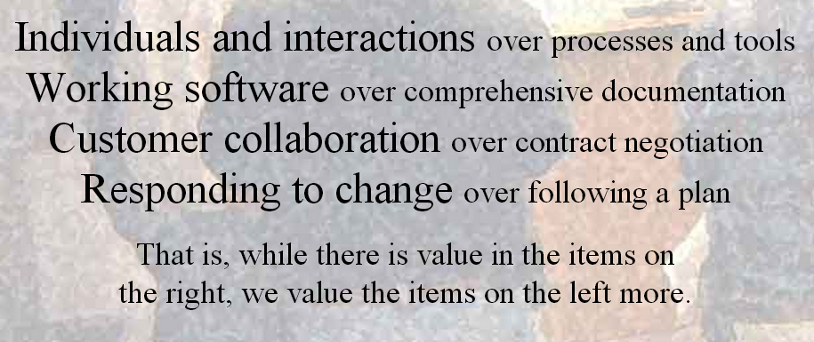
2001: The AGILE Manifesto
http://agilemanifesto.org

Slide 8
But…What Does it Mean? Part 1
Individuals and interactions
  Self-organization and motivation are important in agile, but so are activities like co-location and pair programming.
Working software
  Working software is much more useful and welcome to a client then documents or ongoing discussions.
http://en.wikipedia.org/wiki/Agile_software_development

Slide 9
But…What Does it Mean? Part 2
Customer collaboration
  Requirements cannot be fully collected at the beginning of the software development cycle, so continuous customer or stakeholder involvement is critical.
Responding to change
  Agile development is focused on quickly responding to changes of circumstance. Continuous, evolutionary development constructively addresses such changes.
http://en.wikipedia.org/wiki/Agile_software_development

Slide 10
AGILE Principles: 01 - 04
Customer satisfaction via rapid delivery of useful software
Welcomes changes requirements, even late in development
Frequent delivery of working software (in weeks, not months)
Working software is the principal measure of progress
http://en.wikipedia.org/wiki/Agile_software_development

Slide 11
AGILE Principles: 05 – 08
Constant, sustainable pace of development
Close collaboration between business and developers
Face-to-face conversation is the best form of communication
Projects are done best by trusted, motivated individuals
http://en.wikipedia.org/wiki/Agile_software_development

Slide 12
AGILE Principles: 09 - 12
Continuous attention to technical excellence and good design
Simplicity - minimizing unnecessary work - is essential
Self-organizing teams are the most effective working model
Regular adaptation to changing circumstances is inevitable
http://en.wikipedia.org/wiki/Agile_software_development

Slide 13
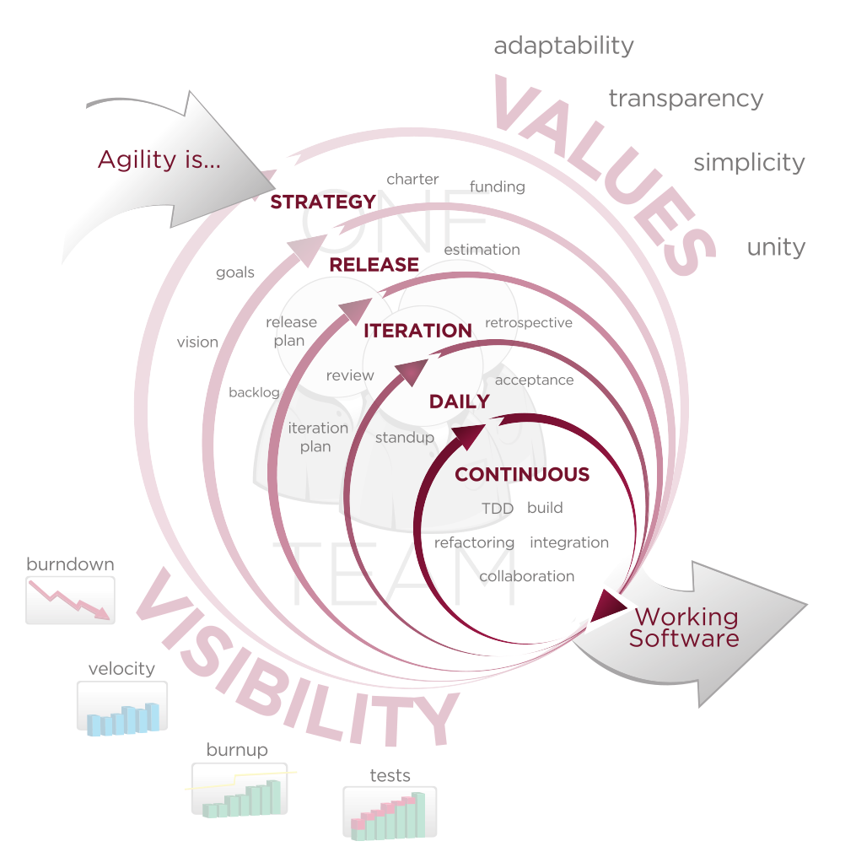
AGILE Illustrated
http://en.wikipedia.org/wiki/Agile_software_development

Slide 14
AGILE SOFTWARE DEVELOPMENT
Extreme Programming

Slide 15
AGILE & Extreme Programming
Extreme Programming (XP) is one of the first Agile-influenced Software Development approaches to go mainstream. It was very popular with companies during the dot-com boom.
XP is also very popular with customers because it puts their fulfillment, priorities and satisfaction first.
XP aims to quickly deliver product to customers with their highest priority features developed first, at the highest possible quality. Speed, utility and quality are the themes.
http://en.wikipedia.org/wiki/Extreme_programming_practices

Slide 16
AGILE & Extreme Programming
XP is popular with IT professionals because it is inclusive. Managers, customers, and developers are all on a “flat” team that has dedicated itself to delivering high quality software.
XP stresses four important themes:
            Communication
            Simplicity
            Feedback
            Courage
http://en.wikipedia.org/wiki/Extreme_programming_practices

Slide 17
Extreme Programming (XP) Practices
The main planning process within XP is the Planning Game, whose purpose is to guide production. Instead of trying to predict exact delivery dates, the Planning Game “steers the project" to delivery using a flexible, collaborative approach.
The Planning Game occurs once per iteration, usually every week. It is normally divided into two parts:
          Release Planning
          Iteration Planning
http://en.wikipedia.org/wiki/Extreme_programming_practices

Slide 18
Release Planning (Stage 1)
Release Planning involves both customers and developers, who meet and agree on what functionality will be in the next set of releases and when those releases will be delivered.
There are three phases:
  1. Exploration: In this phase the customer will provide a shortlist of high-value requirements for the system. These will be written down on user story cards.
http://en.wikipedia.org/wiki/Extreme_programming_practices

Slide 19
Release Planning (Stages 2 & 3)
  2. Commitment: In this phase customers and developers commit themselves to the functionality that will be included and the date when it will be released.
  3. Steering: In this phase the plan is adjusted. New requirements can be added and/or existing requirements can be changed or removed.
http://en.wikipedia.org/wiki/Extreme_programming_practices

Slide 20
XP: Iteration Planning - A
Iteration Planning focuses on coordinating internal tasks of the development team, i.e. who will be doing what. The customer is not involved. It also consists of three phases:
  1. Exploration: In this phase the requirement will be translated to different tasks. The tasks are recorded on task cards.
http://en.wikipedia.org/wiki/Extreme_programming_practices

Slide 21
XP: Iteration Planning - B
  2. Commitment: The tasks will be assigned to the programmers and the time it takes to complete will be estimated by those who are responsible for doing the work.
  3. Steering: In this phase the tasks are performed and the end result is matched with the original user story to ensure that the developers are still working on the highest priority aspects of the product.

Slide 22
XP Related YouTube Videos
Comprehensive Lecture on Extreme Programming
  http://www.youtube.com/watch?v=XP4o0ArkP4s
The Strengths and Weaknesses of Extreme Programming
  http://www.youtube.com/watch?v=LkhLZ7_KZ5w
XP, Scrum, Lean, Kanban & Back Again
  https://www.youtube.com/watch?v=7H67V6noueE

Slide 23
QUESTIONS?

Slide 24
THANK YOU

