Slide 1
SD5953
Successful Project Management
FINAL PRESENTATIONS GUIDELINES
School of Design
The Polytechnic University of Hong Kong

Slide 2
IMPORTANT
Please sit with the members
of your final group project

Slide 3
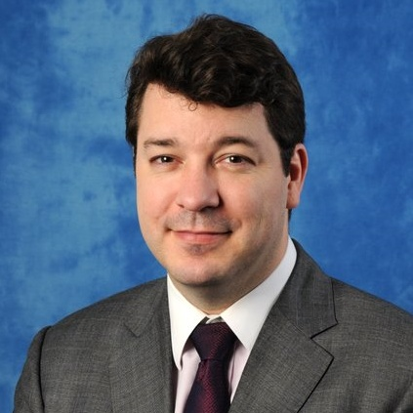
Graham Leach, Instructor
www.graham-leach.com
polyusd5953@gmail.com

Slide 4
Overview
A quick refresher on what you should be doing:
Be sure we know who we need to be (what is our ROLE?)
TCIM = Theme, Concept, Implementation, Manifestation
QQSSA = Qualitative, Quantitative, Supporting, Summary, Appeal
Your presentation must be around 10 Minutes in duration (+/- 2 minutes)
Your objective? CONVINCE US AND MAKE US TOTALLY CONFIDENT IN YOU

Slide 5
Timing & Attendance
Timing:
MONDAY APRIL 15 2019
From 10h30 to 18h30
V1101 (or REMOTE)
Attendance:
Compulsory. Attendance will be taken twice at this event – once at the beginning of the day, once at the end of the day. Missing students at either time will be penalized.

Slide 6
Purpose
CONVINCE US!
This is your final chance to present your entire concept to the people involved with your program.
Now, after Months of continuous development, it’s your time to shine!

Slide 7
Confidence
Take this opportunity to give your peers and stakeholders a solid feel for what you plan to do over the summer semester and develop within us the confidence that you:
    Know why you are doing what you are doing.
    Know what you are doing when you do it.
    Know how to do it when doing it.

Slide 8
Format
Format:
Randomly selected presentations, starting at 10h30 and running to 18h00.
  5 minute setup
  5 minute video
  5 minute live presentation
  5 minute Q&A period.
A faster setup gives you more talking time - so being efficient is rewarded!

Slide 9
Constraints
Constraints:
  Your overall presentation experience must be no longer than 20 minutes.
  Your video introduction and first slide must include the following info:
    School, Year, Program
    Group Name, Group Number
    Group Membership w/POLYU-ID
    Group Champion, Supervisor(s), Mentor(s), Sponsor(s)

Slide 10
Context
Context:
  Imagine that this is a hard-core, final pitch given before a significant resource commitment, perhaps to:
    A Board of Directors
    An Incubator (like Science Park)
    An Angel Investor Group (like HKBAN)
    A Venture Capital company (like 500 Startups)
  It’s show time!
  Come prepared to give it your best shot!

Slide 11
Props & Audience
Props:
Anything goes! Feel free to include any props you feel may help to boost our confidence. You may include anything generated since you started the MET, but remember you have limited time, so make every prop count!
Audience:
Present your FYP plan in all of its glory to your classmates, your supervisors, your instructors and any other stakeholder(s) who may feel they have an interest in your development and progress!
Aim to surprise…and be surprised!

Slide 12
Breaks
Breaks:
Based on how efficiently we can conduct our presentations, the day will feature :
  three (short) breaks or
  two (short) breaks and a (short) lunch

Slide 13
Cutoffs & Deadlines
Registration Cutoff / Deadline:
To level the playing field and prevent “tweaking” of presentations during the day (which distract from engaging with the presentations of your peers), the final version of your group presentation should be emailed to polyusd5953@gmail.com by midnight of the previous day – for those with an exacting nature, that would be:
Final Presentations are Due BEFORE 11PM on SUNDAY APRIL 14 2016

Slide 14
QUESTIONS?

Slide 15
THANK YOU

Slide 16
Suggested Format
A suggested format is provided below:
01: Title/Credits Slide
02: Executive Overview
03: 5 Questions Slide (Why, How, How Much, By Who, By When)
04: Risks & Assumptions Slide
05: Scope & High Level Deliverables Network Slide
06: Critical Path Slide
07: What makes your project special slide #1
08: What makes your project special slide #2
09: What makes your project special slide #3
10: Concluding / Appeal slide

