Slide 1
SD5953
Successful Project Management
REVIEW 07
School of Design
The Polytechnic University of Hong Kong

Slide 2
IMPORTANT
Please sit with the members
of your final group project

Slide 3
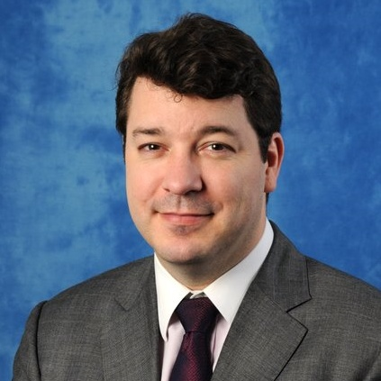
Graham Leach, Instructor
www.graham-leach.com
polyusd5953@gmail.com

Slide 4
What is a Critical Path?
  In project management, a critical path is the sequence of project network activities which add up to the longest overall duration. This determines the shortest time possible to complete the project.
  Any delay of an activity on the critical path directly impacts the project completion date and is to be avoided if possible.
  A project can have several, parallel, near critical paths. An additional parallel path through the network with the total durations shorter than the critical path is called a sub-critical or non-critical path.
http://en.wikipedia.org/wiki/Critical_path_method

Slide 5
Where Does CPM Come From?
The critical path method (CPM) is a project modeling technique developed in the late 1950s by Morgan R. Walker of DuPont and James E. Kelley, Jr. of Remington Rand. Kelley attributed the term "critical path" to the developers of PERT, which was developed for the U.S. Navy nuclear sub program.
The precursors of what came to be known as Critical Path were developed and put into practice by DuPont between 1940 and 1943. The CPM made a significant contribution to the success of the Manhattan Project.
http://en.wikipedia.org/wiki/Critical_path_method

Slide 6
What Does the Critical Path Require?
  Here’s how to generate a Critical Path:
    List all of the activities required to complete the project. This is typically done via a Work Breakdown Structure.
    Create a closed dependency map between the activities without any “dead ends”.
    Supply the estimated duration of each activity.
http://en.wikipedia.org/wiki/Critical_path_method

Slide 7
How Does a Critical Path Work?
  The Critical Path Method locates and calculates the longest chain of dependent tasks within the project. It identifies the earliest and latest times that each task on that chain can start and finish without having the effect of extending the project.
  The tasks that lie along this longest path are "critical“.
  The tasks not on the “critical” path are said to be in the "total float“ of the project. They may be delayed without making the project any longer.
http://en.wikipedia.org/wiki/Critical_path_method

Slide 8
Avoiding Mistakes & Accelerating Results
The best way to avoid making mistakes and accelerating the utility of the Critical Path Method is to:
  Follow an accepted, standardized Project Management methodology such as that of Project Management Institute (PMI). This course is based on the PMI Project Management Body of Knowledge (PMBOK).
  2. Use a project management software that supports the principles of the PMBOK as well as PERT / CPM. This course uses Microsoft Project, which meets that purpose.

Slide 9
QUESTIONS?

Slide 10
Why Do We Track & Report Projects?
The reason why we track and report on projects is because they never unfold according to the way we plan them. Ever.
There is simply no way for a Project Manager to be able to foresee what is going to happen - not just to the project, but also to the global business environment, the company or even the individual people participating in the project.
Tracking & Reporting on Projects is the tool we use to adjust for the inevitable changes that will confront Project, so we can stay focused on the goal – with is a successful conclusion.

Slide 11
The Project Baseline
To manage anything you must be able to measure changes to it. A project “baseline” provides the basis for this by freezing the original project configuration in a “snapshot”.
This “baseline” is then regularly compared to REALITY. Deviations are attributed and measured in terms of how they impact the project. In other words, they are managed.
The baseline gives us a tool to measure the quanta of change, a way to steel ourselves for inevitable changes and a way to decide on optional changes we are going to undertake.

Slide 12
Managing Deviations from the Baseline
When change does arrive - and it will, guaranteed - there are two critical activities that must immediately be undertaken.
The project plan needs to be updated to reflect the impact of the change. Resource allocations, tasks and timing should be double-checked and The Critical Path then recalculated.
Everyone affected needs to be informed, the pace of which is usually driven by the scale of the impact. Small impacts need only be mentioned at regular meetings. Big impacts usually require a special Project meeting.

Slide 13
Blame
One of the unfortunate consequences of the inevitability of change that besets every Project is the consequence that NO project of any respectable size goes 100% “according to plan”.
A LOT of projects are very negatively affected by the changes that come upon them. Change very seldom makes a project faster, easier or cheaper. Normally, it’s the reverse.
So, projects always go over budget somewhere. It’s when they go WAY over budget that the baseline starts getting used as a blame tool. This is because it is no longer seen as a valid management tool.

Slide 14
QUESTIONS?

Slide 15
THANK YOU

