Slide 1
SD5953
Successful Project Management
LAB 6B
School of Design
The Polytechnic University of Hong Kong

Slide 2
IMPORTANT
Please sit with the members
of your final group project

Slide 3
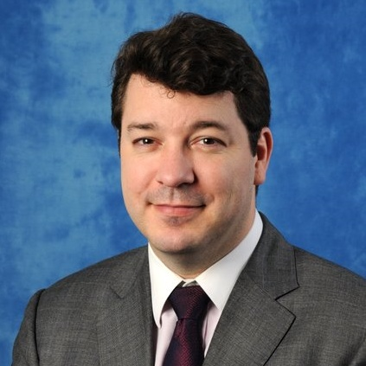
Graham Leach, Instructor
www.graham-leach.com
polyusd5953@gmail.com

Slide 4
The Wedding Project
Planning a wedding is very intimidating for most people. Why?
People generally get married very seldom in their life
Marriages are very expensive in terms of time and money
Marriages are very public with lots of “performance pressure”
So, many people use a Wedding Planner. These are (usually) very capable people with the experience of hundreds of weddings to draw upon to help you. But knowing a little about what they have to deal with will result in a much smoother wedding for you…and maybe even get you a better price from the planner!

Slide 5
The Wedding Plan – Baseline + Reporting
Projects usually experience a certain amount of “drift” as they unfold. This is an expected, normal phenomena that we need to manage, it cannot be avoided. Life happens.
The reason for a project baseline and regular reporting is measure how well the project is adhering to the original plan and detect (and manage) deviations as soon as possible. It is not intended (though it can be use) as a blame mechanism.
Baseline + Reporting composes the “dashboard” the Project Manager uses to navigate the project to a successful end.

Slide 6
LAB 6B
  BASELINE YOUR WEDDING PROJECT
  GENERATE A BASELINE REPORT
  INTRODUCE DEVIATIONS
  REPORT ON CHANGES
  ADJUST AS NEEDED

Slide 7
QUESTIONS?

Slide 8
THANK YOU

