Slide 1
SD5953
Successful Project Management
LAB 6A
School of Design
The Polytechnic University of Hong Kong

Slide 2
IMPORTANT
Please sit with the members
of your final group project

Slide 3
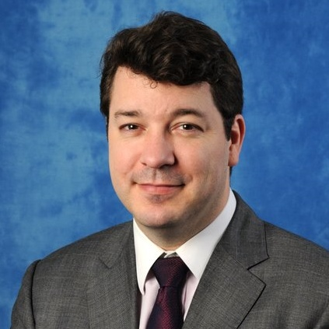
Graham Leach, Instructor
www.graham-leach.com
polyusd5953@gmail.com
Meeting Room, P102 (please book ahead)

Slide 4
The Wedding Project
Planning a wedding is very intimidating for most people. Why?
People generally get married very seldom in their life
Marriages are very expensive in terms of time and money
Marriages are very public with lots of “performance pressure”
So, many people use a Wedding Planner. These are (usually) very capable people with the experience of hundreds of weddings to draw upon to help you. But knowing a little about what they have to deal with will result in a much smoother wedding for you…and maybe even get you a better price from the planner!

Slide 5
The Wedding Plan – Critical Path
The normal timeframe for a Wedding Plan is ONE YEAR. Use MS-Project to determine the Critical Path of your Wedding Project and see if it fits that requirement. If it does not:
Look for tasks which can be shortened or possibly converted from a “finish to start” configuration to “start to start” or even “start to finish”.
Look for ways to compress tasks by (where feasible) adding resources to the task to shorten its duration.

Slide 6
LAB 6A
  Create the shortest possible Critical Path for your Wedding
  Once you fit everything within ONE YEAR you are done!

Slide 7
QUESTIONS?

Slide 8
THANK YOU

