Slide 1
SD5953
Successful Project Management
STATUS TRACKING & REPORTING
School of Design
The Polytechnic University of Hong Kong

Slide 2
IMPORTANT
Please sit with the members
of your final group project

Slide 3
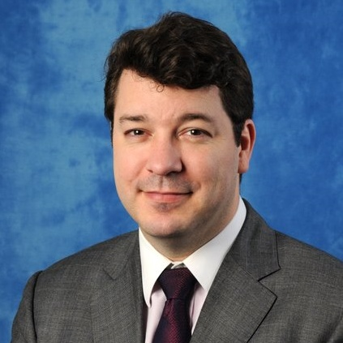
Graham Leach, Instructor
www.graham-leach.com
polyusd5953@gmail.com

Slide 4
Status Tracking and Reporting
Conforming the Project Plan to Reality

Slide 5
Why Do We Track & Report Projects?
The reason why we track and report on projects is because they never unfold according to the way we plan them. Ever.
There is simply no way for a Project Manager to be able to foresee what is going to happen - not just to the project, but also to the global business environment, the company or even the individual people participating in the project.
Tracking & Reporting on Projects is the tool we use to adjust for the inevitable changes that will confront Project, so we can stay focused on the goal – with is a successful conclusion.

Slide 6
The Project Baseline
To manage anything you must be able to measure changes to it. A project “baseline” provides the basis for this by freezing the original project configuration in a “snapshot”.
This “baseline” is then regularly compared to REALITY. Deviations are attributed and measured in terms of how they impact the project. In other words, they are managed.
The baseline gives us a tool to measure the quanta of change, a way to steel ourselves for inevitable changes and a way to decide on optional changes we are going to undertake.

Slide 7
Managing Deviations from the Baseline
When change does arrive - and it will, guaranteed - there are two critical activities that must immediately be undertaken.
The project plan needs to be updated to reflect the impact of the change. Resource allocations, tasks and timing should be double-checked and The Critical Path then recalculated.
Everyone affected needs to be informed, the pace of which is usually driven by the scale of the impact. Small impacts need only be mentioned at regular meetings. Big impacts usually require a special Project meeting.

Slide 8
Blame
One of the unfortunate consequences of the inevitability of change that besets every Project is the consequence that NO project of any respectable size goes 100% “according to plan”.
A LOT of projects are very negatively affected by the changes that come upon them. Change very seldom makes a project faster, easier or cheaper. Normally, it’s the reverse.
So, projects always go over budget somewhere. It’s when they go WAY over budget that the baseline starts getting used as a blame tool. This is because it is no longer seen as a valid management tool.

Slide 9
QUESTIONS?

Slide 10
YouTube Tutorials
How to set a Microsoft Project 2010 Project Baseline
  http://www.youtube.com/watch?v=LYilKaFzpQE
Microsoft Project Saving Project Baseline
  http://www.youtube.com/watch?v=D5tRfjF47mM
Microsoft Project: An Easy Alternative To Baselining
  http://www.youtube.com/watch?v=c7BJ6_1pcgc

Slide 11
SOON: AGILE
Soon I will to cover how the IT industry responded to formal Project Management – AGILE Software Development
AGILE as established to free IT projects from the formalism of the PMI “waterfall” model, heavily influenced as it is by Civil Engineering, with its physical object orientation and one-way time philosophy. PMI basically says that when something has been laid down it cannot be retroactively changed.
AGILE says that when it comes to abstract things (like IT projects) things can absolutely be retroactively changed.

Slide 12
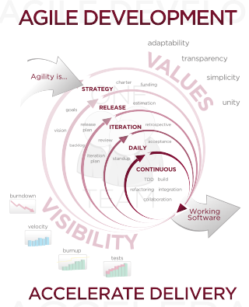
PEEK: AGILE Software Development
http://en.wikipedia.org/wiki/Agile_software_development

Slide 13
Practical Skills Building Exercise
LAB 6B

Slide 14
QUESTIONS?

Slide 15
THANK YOU

