Slide 1
SD5953 Successful Project Management THE CRITICAL PATH METHOD
School of Design
The Polytechnic University of Hong Kong

Slide 2
IMPORTANT
Please sit with the members
of your final group project

Slide 3
Graham Leach, Instructor
www.graham-leach.com
polyusd5953@gmail.com

Slide 4
The Critical Path Method (CPM)
The Tool that Management has
Been Seeking for Centuries

Slide 5
What is a Critical Path?
A critical path is the sequence of project network activities which add up to the longest overall duration. This determines the shortest time possible to complete the project.
Any delay of an activity on the critical path directly impacts the project completion date and is to be avoided if possible.
A project can have several, parallel, near critical paths. An additional parallel path through the network with the total durations shorter than the critical path is called a sub-critical or non-critical path.
http://en.wikipedia.org/wiki/Critical_path_method

Slide 6
Where Does CPM Come From?
The critical path method (CPM) is a project modeling technique developed in the late 1950s by Morgan R. Walker of DuPont and James E. Kelley, Jr. of Remington Rand. Kelley attributed the term "critical path" to the developers of PERT, which was developed for the U.S. Navy nuclear sub program.
The precursors of what came to be known as Critical Path were developed and put into practice by DuPont between 1940 and 1943. The CPM made a significant contribution to the success of the Manhattan Project.
http://en.wikipedia.org/wiki/Critical_path_method

Slide 7
Where is CPM Used?
The Critical Path Method is used with all types of projects:
Software Development
Research Projects
Product Development
Engineering
Construction
Aerospace
Defense
http://en.wikipedia.org/wiki/Critical_path_method

Slide 8
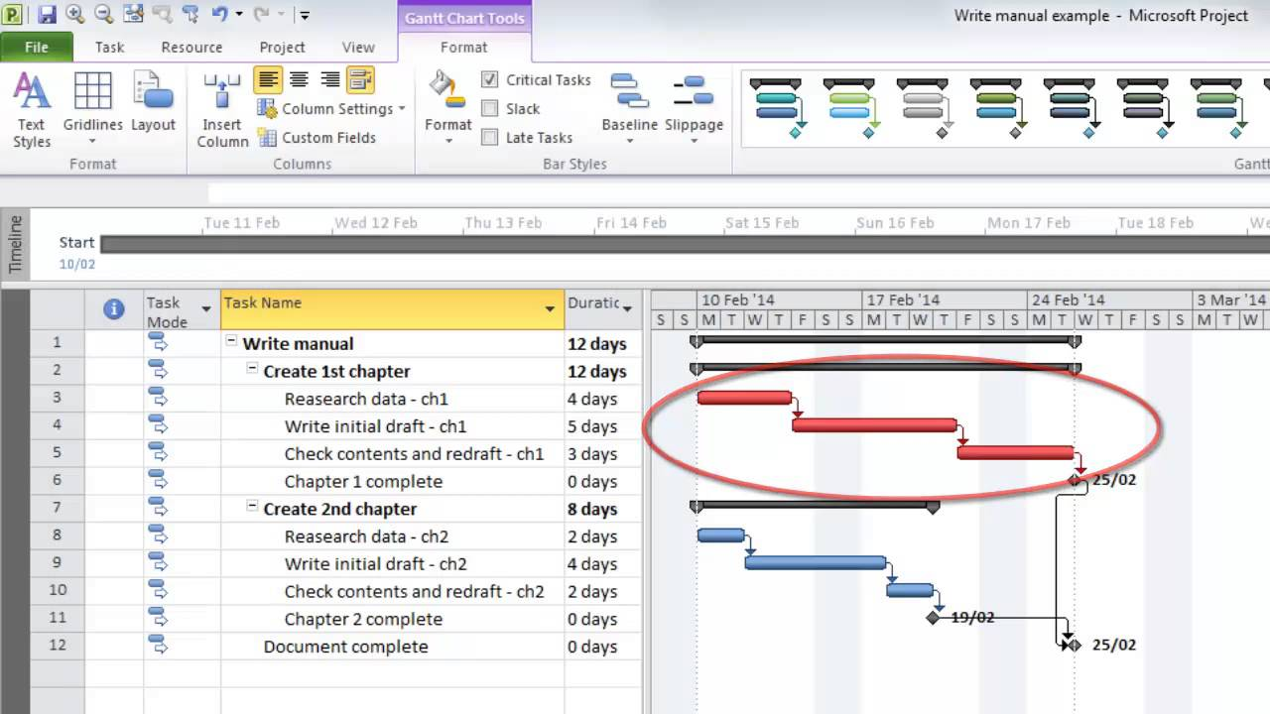
What Does a Critical Path Look Like?
Look for the RED path

Slide 9
What Does the Critical Path Require?
Here’s how to generate a Critical Path:
List all of the activities required to complete the project. This is typically done via a Work Breakdown Structure.
Create a closed dependency map between the activities without any “dead ends”.
Supply the estimated duration of each activity.
http://en.wikipedia.org/wiki/Critical_path_method

Slide 10
How Does a Critical Path Work?
The Critical Path Method locates and calculates the longest chain of dependent tasks within the project. It identifies the earliest and latest times that each task on that chain can start and finish without having the effect of extending the project.
The tasks that lie along this longest path are "critical“.
The tasks not on the “critical” path are said to be in the "total float“ of the project. They may be delayed without making the project any longer.
http://en.wikipedia.org/wiki/Critical_path_method

Slide 11
Avoiding Mistakes & Accelerating Results
The best way to avoid making mistakes and accelerating the utility of the Critical Path Method is to:
Follow an accepted, standardized Project Management methodology such as that of Project Management Institute (PMI). This course is based on the PMI Project Management Body of Knowledge (PMBOK).
2. Use a project management software that supports the principles of the PMBOK as well as PERT / CPM. This course uses Microsoft Project, which meets that purpose.

Slide 12
The BEST Project Management Software

Slide 13
Why We Use MS-PROJECT

Slide 14
QUESTIONS?

Slide 15
YouTube Tutorials
Critical Path Analysis Backgrounder
http://www.youtube.com/watch?v=a4eu05QRetg
How to Show the Critical Path in MS Project
http://www.youtube.com/watch?v=xS9yZwzUoYA
Optimizing the Critical Path in MS Project
http://www.youtube.com/watch?v=OQmXoqTUOiw

Slide 16
Practical Skills Building Exercise
LAB 6A

Slide 17
THANK YOU

