Slide 1
SD5953
Successful Project Management
REVIEW 06
School of Design
The Polytechnic University of Hong Kong

Slide 2
IMPORTANT
Please sit with the members
of your final group project

Slide 3
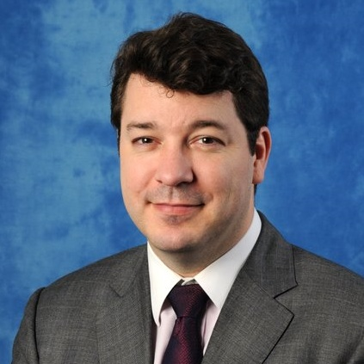
Graham Leach, Instructor
www.graham-leach.com
polyusd5953@gmail.com

Slide 4
Get a Project Champion
Project Champions are critical to Projects. The best Project Champion comes from the highest echelon of organizational power, understands the Project and also knows the strengths and weaknesses of the Project Manager.
The Project Champion operates mainly as a mentor. Their role is primarily political. They are not usually Project “workers”.
To avoid “Project Fatigue”, invoke your Project Champion only when necessary. Use them only after all other avenues and alternatives have been explored.

Slide 5
The Project Talents Roster
Until now, your Project plan has mostly dealt with the inputs the Project needs, not people. In other words, the talents the Project requires as opposed to the identities with the talent.
Identities now need to be established. The first step is to prepare a Project Talents Roster that lists all of the skills the Project needs if it is to be completed successfully.
It is at this point where missing or unavailable talents in the Project will appear, creating a Project “Talent Gap”

Slide 6
Moving From Talents to Identities
In most cases, the Project Charter will have already identified some critical talents (or at least some candidates with those critical talents). Now, actual identities with the needed talent have to start being booked into the Project.
HR is an invaluable resource here. They normally have a good handle on the talent within an organization. If you are lucky, they even have a “Skills Inventory” or can quickly create one.
HR can also be useful in terms of helping you to locate and secure any external or freelance talent needed by the project.

Slide 7
Getting Talent “Buy In”
Obtaining Talent “Buy In” is a multi-skill task composed of formal, social and organizational skills. The Project Manager must seem “attractive” to work with. The Project must have a healthy prognosis and look well-organized. Nobody wants to work on a Project that does not appear to be:
            Significant
            Organized
            Relevant
            Fun

Slide 8
Obtaining Needed Resources
Based on the authority conferred by the Project Charter, the Project Manager soon begins the process of enlisting the (often scarce) Talents required by the Project.
Formal communications will now flow between the Project Management Office (PMO) and the organization regarding booking of specific talents into the Project at specific times.
At this point, resistance often develops as specific resources are (maybe) impacted by the needs of the project. This is the first true hurdle for many Project Managers in their Project.

Slide 9
Identifying Resistance
There are two varieties of resistance:
  Individual: The implicated Talent feels that they have the personal authority or power to resist becoming involved with the Project. This is the “prima donna” effect.
  Institutional: The implicated Talent feels that their existing organization does not support their being involved in the Project and so resists. This is the “good soldier” effect.

Slide 10
Some Motivations for Resistance
There are a myriad of reasons why people resist becoming involved in projects. Here are some (but not all) reasons:
  Some people are very “loyal” to their existing manager(s)
  The work required by the Project may not be interesting
  Project work is often perceived as “extra, unpaid” work
  Some people are simply lazy and only do the minimum
  The Talent involved may dislike the Project Manager
  The Talent being requested is planning to quit
  The Talent is already feeling over-subscribed

Slide 11
How to Overcome Resistance
The first step to overcoming resistance is to properly identify the source of the resistance, its intensity and its motivation.
Be careful. There may be multiple agendas at work, each coming from a different point and at a level of intensity. This phenomena is called “the black cloud”.
The easiest way to overcome “the black cloud” is to use the authority of the Project Charter and involve the “Project Champion” if resistance is ultimately insurmountable.

Slide 12
MS-Project and Task Estimating
MS-Project uses the PERT method to help Project Managers deal with the uncertainty related to estimating task durations.
MS-Project helps Project Managers “triangulate” on task durations by estimating them under different scenarios:
              Optimistic
              Pessimistic
              Best Guess

Slide 13
Maintaining Talent “Buy In”
Projects are composed of equal parts of:
              Politics
              Socializing
              Work
              Talent
              Skill
Forget this and you will probably have a difficult Project. One easy way to obtain Talent “buy in” is to ask them to help with estimating the durations of their Project-related tasks.

Slide 14
Costs in MS-Project
Time and Money are the most important costs associated with a Project. MS-Project provides for several types of costs:
Rate Based Cost: Calculated based on the unit rates for a resource multiplied by the amount of units performed.
Per Use Cost: Calculated each time the resource is used, or once for each complete task that the resource is assigned to.
Fixed Cost: A fixed cost does not change, regardless of task duration or the work performed on the task by a resource.
http://office.microsoft.com/en-001/project-help/overview-of-project-cost-information-HA001223194.aspx

Slide 15
QUESTIONS?

Slide 16
THANK YOU

