Slide 1
SD5953
Successful Project Management
LAB 05
School of Design
The Polytechnic University of Hong Kong

Slide 2
IMPORTANT
Please sit with the members
of your final group project

Slide 3
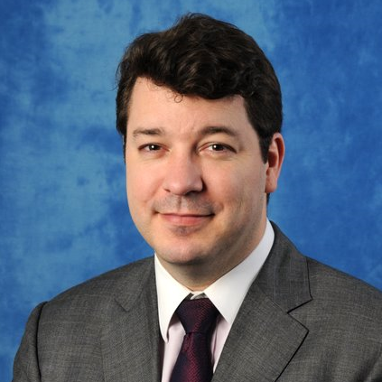
Graham Leach, Instructor
www.graham-leach.com
polyusd5953@gmail.com

Slide 4
LAB 05
  YOUR TASK(s):
Estimate the Duration of Tasks
Assign Tasks to Specific Members of the Wedding Party

Slide 5
The Wedding Project
Planning a wedding is very intimidating for most people. Why?
People generally get married very seldom in their life
Marriages are very expensive in terms of time and money
Marriages are very public with lots of “performance pressure”
So, many people use a Wedding Planner. These are (usually) very capable people with the experience of hundreds of weddings to draw upon to help you. But knowing a little about what they have to deal with will result in a much smoother wedding for you…and maybe even get you a better price from the planner!

Slide 6
The Wedding Plan - Time
The time has come to start tightening up the Wedding Party as an overall project. The normal timeframe for a Wedding Plan is ONE YEAR.
Begin to assign timeframes to all of the individual tasks in your Wedding Project. At this point, a certain amount of estimating will be necessary, which should be reflected in the Assumptions & Risks section of your Broad Brush Project Plan.

Slide 7
The Wedding Plan - People
The following people normally compose your Wedding Team. Some wedding plans include even more participants.
Bride Groom Best Man Maid of Honor
B-Parents G-Parents Ushers Bridesmaids
Planner Caterer Chauffer

Slide 8
Questions?

Slide 9
Thank You

