Slide 1
SD5953
Successful Project Management
Giving a Project Presentation
School of Design
The Polytechnic University of Hong Kong

Slide 2
IMPORTANT
Please sit with the members
of your final group project

Slide 3
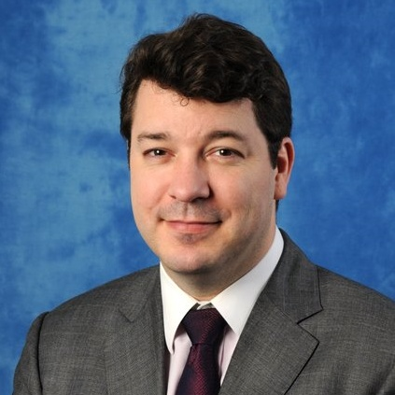
Graham Leach, Instructor
www.graham-leach.com
polyusd5953@gmail.com

Slide 4
Giving a Project Presentation
Improving Ideas by
Exposing them to Scrutiny in a
Friendly, Structured & Constructive Environment

Slide 5
Why Do We Give Presentations?
There are many important reasons why we formally present our ideas to other people in public. Here are just a few:
  It forces us to concentrate on and focus our concept(s)
  It prevents procrastination by giving us a deadline
  It helps to us to structure what we desire to do
  It gives us valuable exposure and momentum
  It solicits advice and assistance from others
  It provides a valuable chance to practice

Slide 6
Presentation – Pick a Target
Be sure to declare who the intended target of your presentation is so the audience can approach it with the “right frame of mind”. Some popular targets are:
  A Government Department Representative
  A Venture Capital Company Investor
  An Academic Board or Committee
  A Social Group or Club
  A Supervisor
  Pick any authority you want – just be sure to declare them

Slide 7
Presentation – General Format A
Your presentation should be about TEN (10) to TWELVE (12) minutes long, and it needs to cover these information clusters:
  Qualitative: Talk about “the problem” that your project solves. Talk about how it makes you feel. Talk about why it exists. Talk about its impact on us? Tell us what you propose to do about it. Explain why the time to do this project is now.
  Quantitative: Talk about specifics of “the problem” and also your solution to it. Use highly structured information, models, numbers and other type of measurable and visual data.

Slide 8
Presentation – General Format B
  Additional & Supporting: Provide any information that further supports your proposal. Showcase and demonstrate any already existing work or partial solution(s).
  Summary & Conclusion: Tie everything together to generate a feeling of confidence in the viewer toward your proposed outcome and that your deliverable can achieve it.
  Solicitation: Issue a sincere appeal for assistance from your audience to enable you to complete the project.

Slide 9
Example Presentation
Example Research Project Proposal

Slide 10
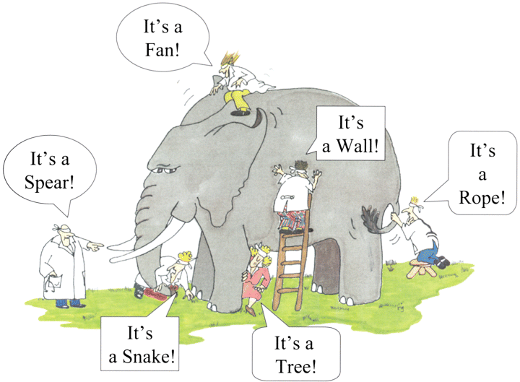
Sustainable Cultures of Creativity & Innovation
Example Research Grant Proposal

Slide 11
Intended Audience
The intended audience(s) of this presentation are:
  A Government Official (to obtain a research budget)
  A Local University (to find an institutional host)
  A Department (to construct a peer panel)
  A Supervisor (to recruit a good mentor)

Slide 12
Overview
Theme: Why do institutions “do” creativity so badly?
Concept: Are there verifiable factors that institutions now deploy, consciously or not, to support (or suppress) creativity?
Implementation: Study examples of successful and failing “creative” institutions to see what is working and what isn’t.
Manifestation: Publish validated factors. Assemble idealized archetypes. Author guidebook. Create support and educational ecosystem to enable institutions to “do” creativity better.

Slide 13
Project Plan – Phases
This project is designed to unfold according to the four step creative process as defined by Graham Wallace in his 1926 book The Art of Thought:
            Preparation
            Incubation
            Illumination
            Verification / Revision

Slide 14
Project Plan - Preparation
Stage: 1
Duration: 2 months
Description: The Project will synchronize with the current “state of the art”. Extensive study of the existing literature will be performed. Review. Discussion.
Deliverable: A focused, viable research question which can be feasibly completed within the project timeframe.

Slide 15
Project Plan - Incubation
Stage: 2
Duration: 3 months
Description: This phase is primarily composed of synthesis, integration, contemplation and conversation with qualified colleagues / experts around the world.
Deliverable: An insight that merits further investigation within the theme of the overall project mandate.

Slide 16
Project Plan - Illumination
Stage: 3
Duration: 4 months
Description: In this phase, the Project actively undertakes the investigation of a specific research question. Intensive data generation and collaboration occur.
Deliverable: An academically valid investigation of the research question with an aim to produce new knowledge.

Slide 17
Project Plan – Verification / Revision
Stage: 4
Duration: 3 months
Description: In this phase, the Project enlists the assistance of experts in the field to corroborate findings and also support the publication of the new insights.
Deliverable: A published work that presents the new, validated insights in a way that is acceptable to academia.

Slide 18
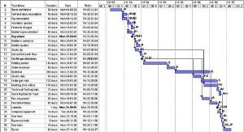
Project Plan – GANTT Chart (draft)

Slide 19
Existing Assets
The following assets are already in place:
  A 60+ page DRAFT Research Proposal has been written
  20+ international academics are advising this project
  100+ research targets have already been identified
  A potential University has already been identified
  A potential Department has been contacted
  A potential Supervisor has been found

Slide 20
Required Inputs & Expected Outputs
  INPUT: A project Duration of 1 year
  INPUT: A project Budget of about HKD1M
  INPUT: A project Subject Group of 100+ Institutions
  INPUT: A project Project Staffing of around 3 people
  OUTPUT: Four (4) Tangible Deliverables comprised of:
    A 100-page book featuring a validated theory
    A roster of understandable, feasible archetypes
    A comprehensive, accessible educational program
    An ecosystem of educators, facilitators and experts

Slide 21
Conclusion and Summary
  This Project is designed to provide a double benefit to society:
  Institutions will receive a validated methodology and support to implement “creativity-friendly” workplaces. This will enable them to generate and capture more creativity than their (currently) inadequate creative strategies do now.
  Staff will be enabled to release their creative urges in a sustainable and structured way. This will improve their quality of life and reduce frustration. It will also enhance the career prospects of workers whose creative talents would have otherwise been ignored.

Slide 22
Call for Support
  If anyone viewing this presentation is in a position to offer assistance to propel this project forward, I would be very happy to hear from you! I am looking for the following input:
  Feedback & Input
  Constructive Criticism
  Related Research Findings
  Relevant Contacts or Experience
  Any other means of furthering this project
  Please contact me at polyusd5953@gmail.com

Slide 23
Questions?

Slide 24
Thank You

