Slide 1
SD5953
Successful Project Management
REVIEW 05
School of Design
The Polytechnic University of Hong Kong

Slide 2
IMPORTANT
Please sit with the members
of your final group project

Slide 3

Graham Leach, Instructor
www.graham-leach.com
polyusd5953@gmail.com

Slide 4
Wikipedia - Work Breakdown Structure
A Work Breakdown Structure (WBS) is a deliverable-oriented decomposition of the elements of a project into ever smaller components. It is used to group and relate the elements that compose a project to reveal underlying relations.
The WBS helps to provide a framework for further Project Management related work, like cost estimating, schedule development, structuring, sequencing and project control.
A WBS element may be related to a product, data or a service.
http://en.wikipedia.org/wiki/Work_breakdown_structure

Slide 5
WBS Element Attributes
Four attributes common to every WBS element are:
It directly relates to the Scope of the project.
It falls between the Start and End time of the project.
It is paid for from the Budget of the project.
It utilizes the Resources assigned to the project.
http://en.wikipedia.org/wiki/Work_breakdown_structure

Slide 6
A WBS Organizes Work Packages
A Work Package exists at the lowest level of a project, at the ATOMIC level. ATOMIC tasks cannot be further decomposed. They live inside the WBS deliverable network “boxes”. They must be:
  In accordance with the WBS “Sanity Checks”
  Capable of producing a measurable deliverable
  Able to be realistically and confidently estimated
http://en.wikipedia.org/wiki/Work_breakdown_structure

Slide 7
The ATOMIC Task
An ATOMIC task cannot be decomposed further without losing information. To protect from this, ensure that your decomposed tasks always meaningfully answer THE W5:
  Who
  What
  When
  Where
  Why

Slide 8
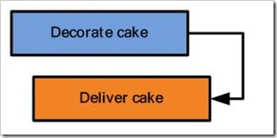
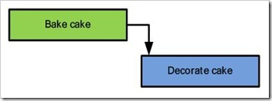
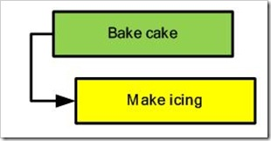
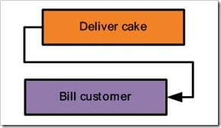
Predecessors and Successors
Finish-to-start (FS)
Finish-to-finish (FF)
Start-to-start (SS)
Finish-to-finish (FF)
http://blogs.msdn.com/b/project/archive/2008/07/29/back-to-basics-understanding-task-dependencies.aspx

Slide 9
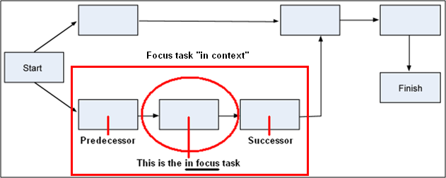
Looking at a Focus Task “In Context”
A Focus task is taken “in Context” when it is examined along with the implications of its Predecessor and Successor.

Slide 10
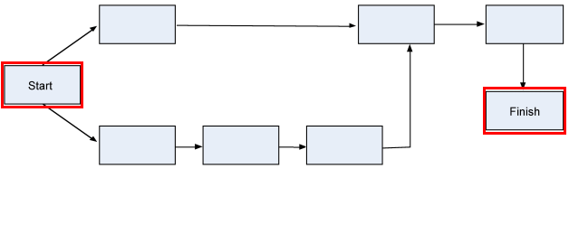
Special Cases - Part 1 (Start & Finish)
Only the Start and Finish events may be missing a Predecessor or a Successor, respectively.
Technically speaking, they are not tasks. They are notations.

Slide 11
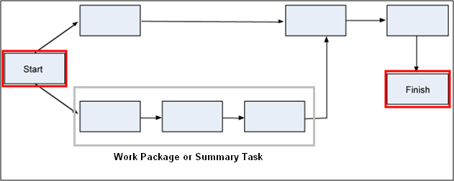
Special Cases - Part 2 (Summary Tasks)
Summary Tasks (or Work Packages) are used to organize tasks into “chains of tasks” that can be assigned on a macro basis.
Technically speaking, they are not tasks. They are notations.

Slide 12
A Danger: Dangling Tasks
A dangling task is a task which has no successor. Only the SCOPE is allowed to have no successor, so you can think of a dangling task as an unintentional “dead end” in the project.
Dangling tasks negatively impact the ability of MS-PROJECT to work properly because it looks to the software like there are two “ends” to the project, which is technically impossible.

Slide 13
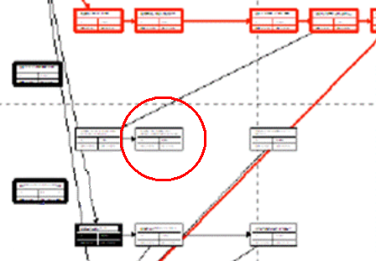
How to Find Dangling Tasks
Dangling Tasks can be hard to spot in the default view, so the easiest way to find them is to switch to the network diagram.
VIEW | NETWORK DIAGRAM

Slide 14
Thank You

