Slide 1
SD5953
Successful Project Management
LAB D
School of Design
The Polytechnic University of Hong Kong

Slide 2
IMPORTANT
Please sit with the members
of your final group project

Slide 3
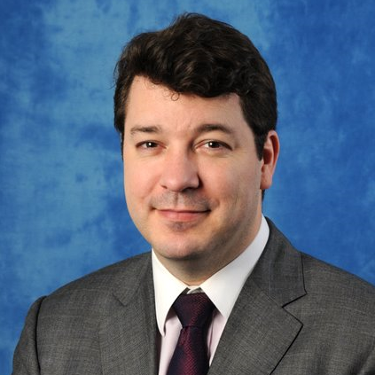
Graham Leach, Instructor
www.graham-leach.com
polyusd5953@gmail.com

Slide 4
LAB D
Link the WEDDING PROJECT Work Packages
into Meaningful Chains of Execution

Slide 5
It’s All About The Links…
Take the ~100 tasks generated from LAB C that you grouped together and decide if they represent Work Packages.
Once you are done, sequence them in logical way.
Figure out how to deal with tasks that do not fall naturally inside your defined Work Packages.
Link everything together into a closed network that has no dangling tasks.

Slide 6
Questions?

Slide 7
Thank You

