Slide 1
SD5953
Successful Project Management
Predecessors and Successors
School of Design
The Polytechnic University of Hong Kong

Slide 2
IMPORTANT
Please sit with the members
of your final group project

Slide 3

Graham Leach, Instructor
www.graham-leach.com
polyusd5953@gmail.com

Slide 4
It is all About Connections...
But What Exactly Are We Connecting?
Explaining the Relationship between
Work Packages and ATOMIC Tasks

Slide 5
The Work Package – Part 1
In Project Management, a Work Package (WP) is a subset of tasks in a project that can be logically grouped together, separated, and assigned as a unit for implementation.
Work packages are defined by a number of attributes: Description, Required Resources, Effort Estimate, Duration Estimate, Schedule, Risks and Budget. This sometimes leads to their being misidentified as a Project. They are NOT a project because they lack meta-information such as a Charter and Scope. Think of them as more like “sprints”.
http://en.wikipedia.org/wiki/Work_package

Slide 6
The Work Package – Part 2
In Project Management, Work Packages are often used as an intermediate (or macro) level tool for formally managing grouped inputs to a Project. Their impact on a project is usually tracked via a Work Authorization or Control Account.
Work Packages are used extensively in Earned Value Management where actual progress made in the Work Package (called Earned Value) is compared to the Planned Value that should have been earned. The difference between the two forms the foundations of Project Variance Analysis.
http://en.wikipedia.org/wiki/Work_package

Slide 7
The ATOMIC Task
An ATOMIC task cannot be decomposed further without losing information. To protect from this, ensure that your decomposed tasks always meaningfully answer THE W5:
  Who
  What
  When
  Where
  Why

Slide 8
Task Relationships
Creating Information Via Proximity

Slide 9
Predecessors and Successors
ALL projects are composed of a series of actions taken over a period of time. Collectively, these actions (when completed) will accomplish the Scope of the project.
A large part of the “art” of Project Management is effectively breaking down the Scope into a set of separate but highly related chains of tasks to be later delegated and actioned on.
The location of steps within these chains determines their contextual link to each other, as predecessors or successors.

Slide 10
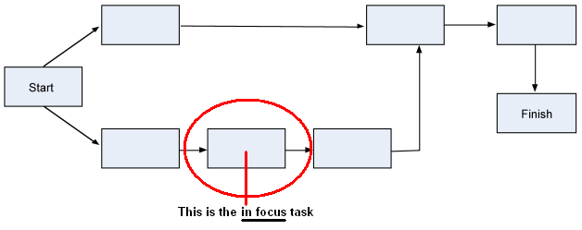
The Focus (or “in focus”) Task
An in focus task means that it is currently under consideration.

Slide 11
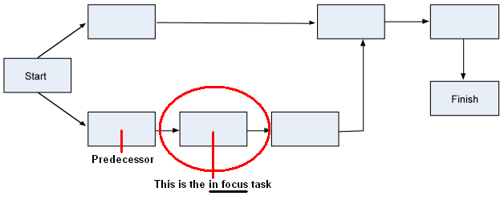
What is a Predecessor?
A Predecessor is a task that comes BEFORE the Focus task.

Slide 12
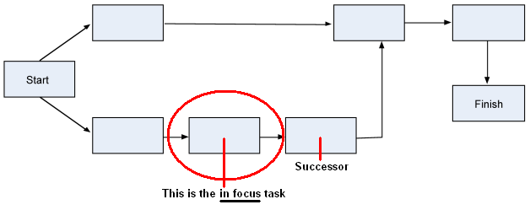
What is a Successor
A Successor is a task that comes AFTER the Focus task.

Slide 13
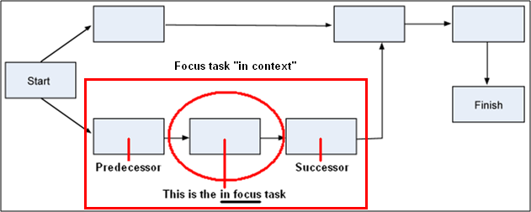
Looking at a Focus Task “In Context”
A Focus task is taken “in Context” when it is examined along with the implications of its Predecessor and Successor.

Slide 14
Connecting Tasks
The Different Forms of Task Sequencing

Slide 15
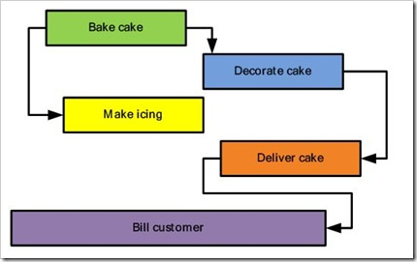
Example: Cake Sale Task Network
http://blogs.msdn.com/b/project/archive/2008/07/29/back-to-basics-understanding-task-dependencies.aspx

Slide 16
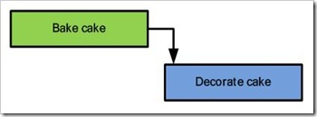
The Finish to Start Dependency
The finish-to-start (FS) dependency is the most common type and is the default action in Microsoft Project.
In this relationship, the second task in the relationship can't begin until the first task finishes.
http://blogs.msdn.com/b/project/archive/2008/07/29/back-to-basics-understanding-task-dependencies.aspx

Slide 17
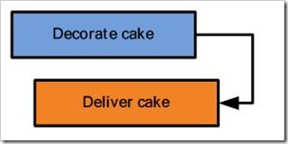
The Finish to Finish Dependency
Finish-to-finish (FF) dependencies require that the first task be finished in order for the second task to finish.
In this relationship, the second task can finish any time after the first task finishes.
http://blogs.msdn.com/b/project/archive/2008/07/29/back-to-basics-understanding-task-dependencies.aspx

Slide 18
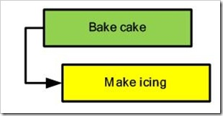
The Start to Start Dependency
Start-to-start (SS) dependencies are for when the second task in the relationship can't begin until after the first task begins.
In this relationship, the tasks do not have to begin at the same time, a lag is allowed.
http://blogs.msdn.com/b/project/archive/2008/07/29/back-to-basics-understanding-task-dependencies.aspx

Slide 19
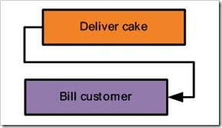
The Start to Finish Dependency
Start-to-finish (SF) dependencies are for when the second task in the relationship can't finish until the first task starts.
In this relationship, the second task can finish any time after the first task starts, even beforehand if that is appropriate.
http://blogs.msdn.com/b/project/archive/2008/07/29/back-to-basics-understanding-task-dependencies.aspx

Slide 20
Special Task Cases

Slide 21
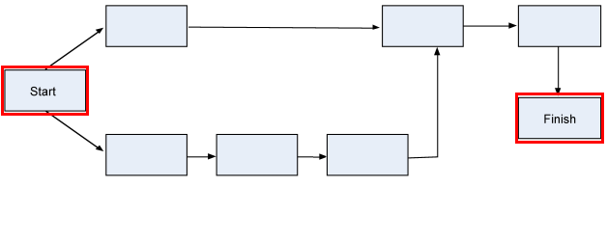
Special Cases - Part 1 (Start & Finish)
Only the Start and Finish events may be missing a Predecessor or a Successor, respectively.
Technically speaking, they are not tasks. They are notations.

Slide 22
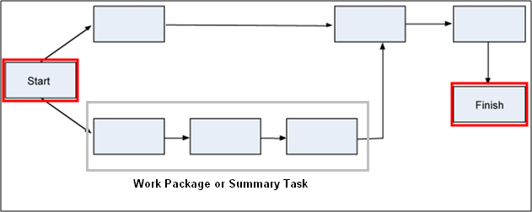
Special Cases - Part 2 (Summary Tasks)
Summary Tasks (or Work Packages) are used to organize tasks into “chains of tasks” that can be assigned on a macro basis.
Technically speaking, they are not tasks. They are notations.

Slide 23
Task Network Troubleshooting

Slide 24
A Danger: Dangling Tasks
A dangling task is a task which has no successor. Only the SCOPE is allowed to have no successor, so you can think of a dangling task as an unintentional “dead end” in the project.
Dangling tasks negatively impact the ability of MS-PROJECT to work properly because it looks to the software like there are two “ends” to the project, which is technically impossible.

Slide 25
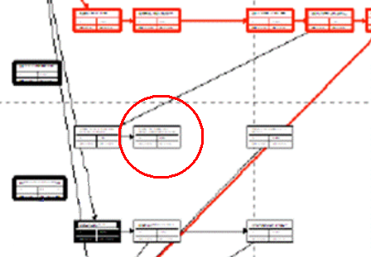
How to Find Dangling Tasks
Dangling Tasks can be hard to spot in the default view, so the easiest way to find them is to switch to the network diagram.
VIEW | NETWORK DIAGRAM

Slide 26
YouTube Tutorials
271 - Microsoft Project 2007 (Constraints & Dependencies)
  http://www.youtube.com/watch?v=EGbAVn5nQdk
272 - Microsoft Project 2010 (5 Lessons Learned)
  http://www.youtube.com/watch?v=ysD4Drml5Y4

Slide 27
Interactive Exercise
Fixing a “Troubled” Task Network

Slide 28
Cake Sale: Task Network
DO YOU SEE ANY PROBLEM(S) WITH THIS TASK NETWORK?

Slide 29
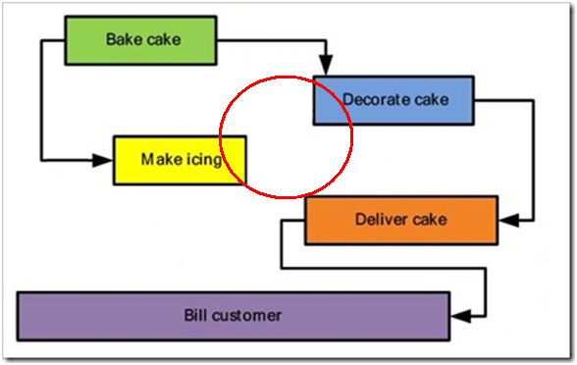
Cake Sale: What’s Missing? Part 1
WHERE DOES THE ICING GO? THIS IS A DANGLING DEPENDENCY!

Slide 30
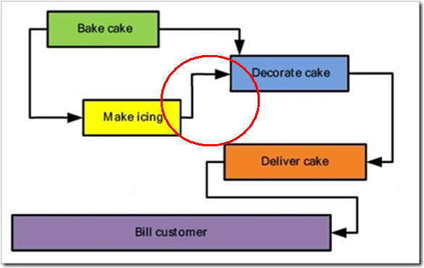
Cake Sale: What’s Missing? Part 1
ALWAYS ELIMINATE “DANGLING” DEPENDENDIES!

Slide 31
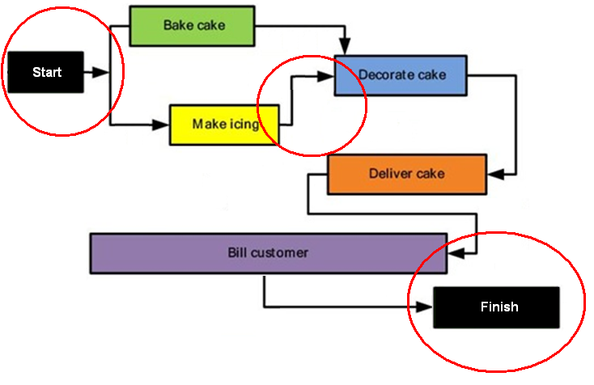
Cake Sale: What’s Missing? Part 2
ALSO - ALWAYS SHOW WHERE THE “ENDS” OF THE PROJECT ARE!

Slide 32
Questions?

Slide 33
Please Watch the Videos
Then Do LAB D

Slide 34
LAB 04
Watch the videos mentioned in the two preceding lectures

Slide 35
Thank You

