Slide 1
SD5953
Successful Project Management
Work Breakdown Structure
School of Design
The Polytechnic University of Hong Kong

Slide 2
IMPORTANT
Please sit with the members
of your final group project

Slide 3

Graham Leach, Instructor
www.graham-leach.com
polyusd5953@gmail.com

Slide 4
Work Breakdown Structure
Deconstructing and Organizing Atomic Tasks

Slide 5
Wikipedia - Work Breakdown Structure
A Work Breakdown Structure (WBS) is a mapping of the deliverable-oriented elements of a project down to the smallest feasible component. The WBS is used to help group and link the elements that compose a project, to expose their underlying relations.
The WBS supports further Project Management refinment and development such as cost estimating, schedule development, task structuring, task sequencing and project control.
A WBS element may relate to a product, data or a service.
http://en.wikipedia.org/wiki/Work_breakdown_structure

Slide 6
The Work Breakdown Structure
A WBS helps to decompose a project into a hierarchy of phases, deliverable networks and work packages. Ultimately, it is a tree-like structure that clearly shows the relationships and subdivisions of the inputs required to achieve the Scope.
A WBS is arrived upon by successively decomposing the project Scope into ever more specific and granular phases and steps.
Once a WBS Element cannot be decomposed any further, the WBS has arrived at the Work Package or ATOMIC Task level.
http://en.wikipedia.org/wiki/Work_breakdown_structure

Slide 7
WBS Coding Schemes
It is common for a WBS element to have a systematic number.
This comes from the fact that the WBS was developed by a large, highly structured organization (DoD). The purpose of the numbering is to provide a consistent way to use a WBS across systems regardless of vendor or service. It also aids in recognizing WBS elements appearing in any written context.
http://en.wikipedia.org/wiki/Work_breakdown_structure

Slide 8
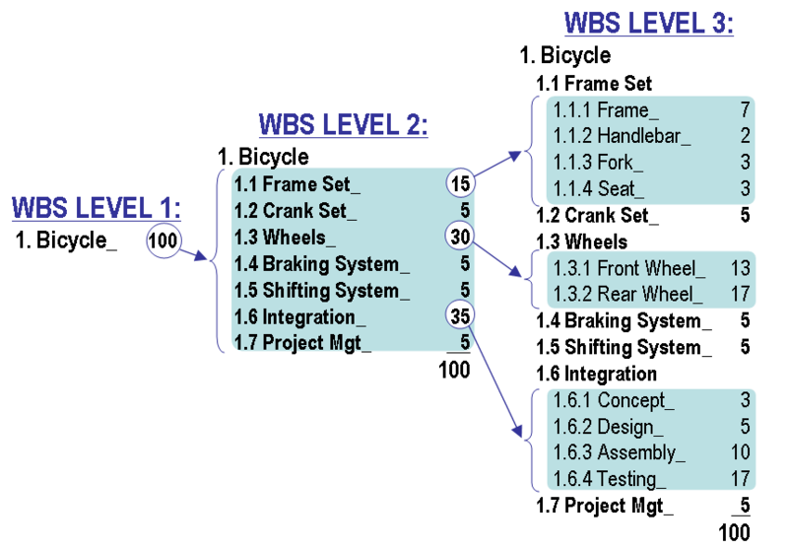
Example Coding – A Bicycle BOM
1.1.2 Handlebar identifies that item as a Level 3 element. This information is encoded, because its name is composed of three numbers separated by a decimal point, implying that there are two more levels of components.
http://en.wikipedia.org/wiki/Work_breakdown_structure

Slide 9
WBS Misconceptions
A WBS is NOT a complete project document. It acts more like a transitional document, and input to later stages of work. A WBS is not a Project Plan because:
It does not say WHO is to accomplish the tasks in the project.
It does not specify WHEN the tasks in the project are done.
http://en.wikipedia.org/wiki/Work_breakdown_structure

Slide 10
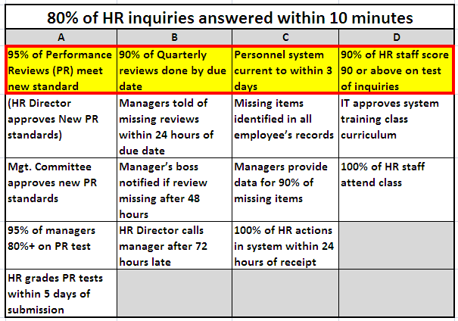
HR Example - “Layers”
A HORIZONTAL view is the “Layers” of the Project

Slide 11
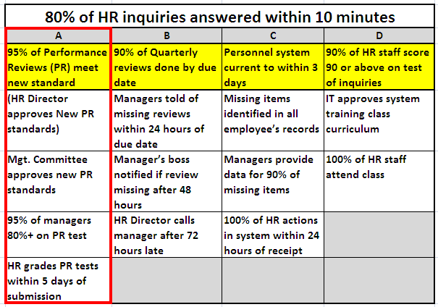
HR Example – “Pillars”
A VERTICAL view is the “Pillars” of the Project

Slide 12
WBS Element Attributes
Four attributes common to every WBS element are:
It directly relates to the Scope of the project.
It falls between the Start and End time of the project.
It is paid for from the Budget of the project.
It utilizes the Resources assigned to the project.
http://en.wikipedia.org/wiki/Work_breakdown_structure

Slide 13
WBS Element “Sanity Checks”
80 Hour Rule: No single activity or group of activities to produce a single deliverable should be more than 80 hours of effort.
Single Reporting Period Rule: No activity or series of activities should be longer than a single reporting period. If the project team is reporting progress monthly, then no single activity or series of activities should be longer than one month long.
Common Sense Rule: If something looks or feels wrong while you are constructing the WBS, it probably is. Feel free to redo.
http://en.wikipedia.org/wiki/Work_breakdown_structure

Slide 14
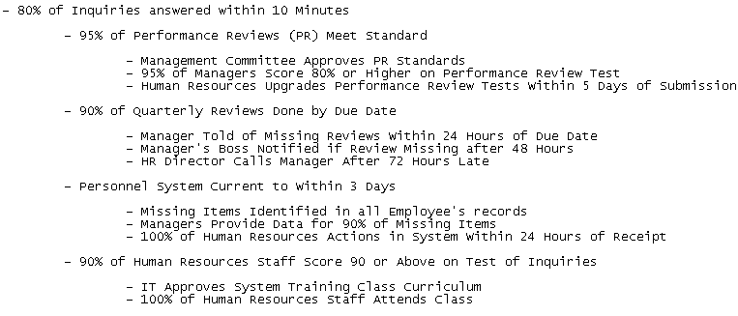
Is This Example A WBS?
DISCUSSION: Is this a proper WBS?

Slide 15
Work Packages & ATOMIC Tasks
Getting Down to the Checklist

Slide 16
A WBS Organizes Work Packages
Work Packages exist at the lowest management level of a project.
Work Packages are composed of at least one ATOMIC task, which is work that cannot be any further decomposed, and must be:
  In accordance with the WBS “Sanity Checks”
  Capable of producing a measurable deliverable
  Able to be realistically and confidently estimated
http://en.wikipedia.org/wiki/Work_breakdown_structure

Slide 17
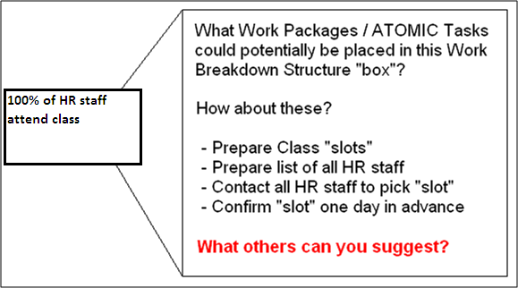
Where Work Packages Go in a WBS

Slide 18
YouTube – WBS Tutorials
242 - Versatile Company (4 min)
  http://www.youtube.com/watch?v=6oEMEo7sRy0
243 - SimonSez (16 min)
  http://www.youtube.com/watch?v=wPAoikQ5k-s

Slide 19
Questions?

Slide 20
Thank You

