Slide 1
SD5953
Successful Project Management
Project Charter Submissions
School of Design
The Polytechnic University of Hong Kong

Slide 2
IMPORTANT
Please sit with the members
of your final group project

Slide 3
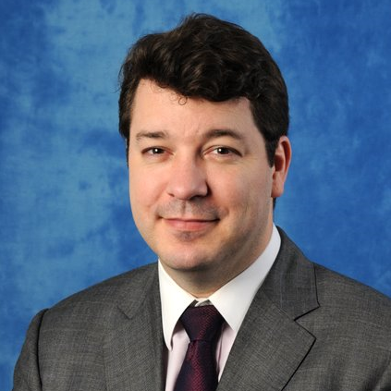
Graham Leach, Instructor
www.graham-leach.com
polyusd5953@gmail.com

Slide 4
What I Wanted

Slide 5
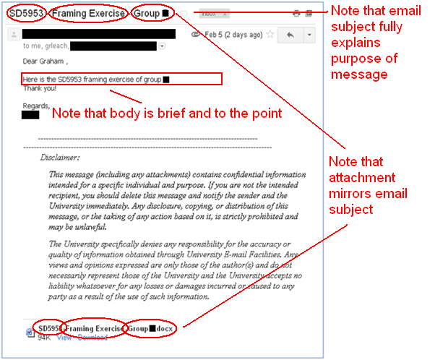
From Framing Exercise Lecture

Slide 6
What I Got

Slide 7
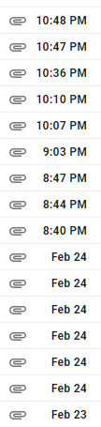
Everyone Was ON TIME

Slide 8
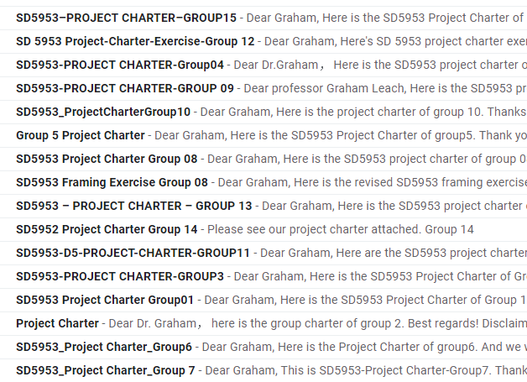
BUT Not Everyone Was ON TASK

Slide 9
Questions?

Slide 10
Thank You

