Slide 1
SD5953 Successful Project Management REVIEW 02
School of Design
The Polytechnic University of Hong Kong

Slide 2
IMPORTANT
Please sit with the members
of your final group project

Slide 3
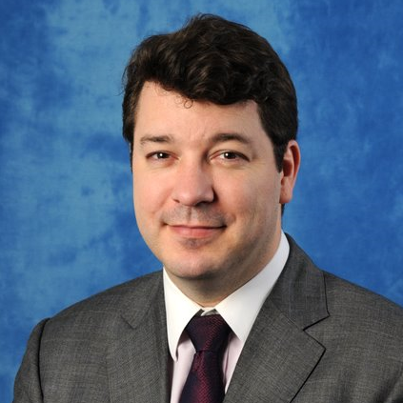
Graham Leach, Instructor
www.graham-leach.com
polyusd5953@gmail.com

Slide 4
SMART Goals
S.M.A.R.T. is an acronym for the 5 steps of creating a high-quality goal, which is a necessary pre-condition for a positive result:
Specific
Measurable
Attainable
Relevant
Time-Based
http://sbinformation.about.com/od/businessmanagemen1/a/businessgoals.htm

Slide 5
10 Important Project Management Steps
Pitch the Project
Get the Project
Identify the High Level Deliverables Network (HLDN)
Develop the Work Breakdown Structure (WBS)
Figure out the Project Schedule
Get People to Work for You
Keep Track of Your Results
Deliver the Goods
Finish the Job
Get Paid

Slide 6
10 Important Project Management Docs
Project Pitch
Project Contract
High-Level Deliverables Network (HLDN)
Work Breakdown Structure (WBS)
Scope & Other Considerations
Project Schedule
Talents Roster
Reporting
Closure
Cash

Slide 7
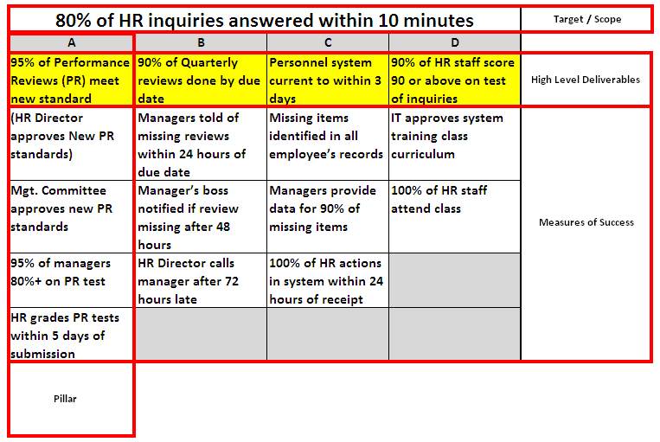
HLDN Summary

Slide 8
Thank You

