Slide 1
SD5906 Globalization in New Media Design and Technology
VEVUE ACTIVATION
School of Design
The Polytechnic University of Hong Kong

Slide 2
IMPORTANT
Please sit with the members
of your final group project

Slide 3
VEVUE Account Activation
Everyone involved with this program has been allocated some VEVUE tokens, courtesy of the VEVUE project.
Please activate a VEVUE account, then tell us your VEVUE ID
https://bit.ly/2HzJKnF

Slide 4
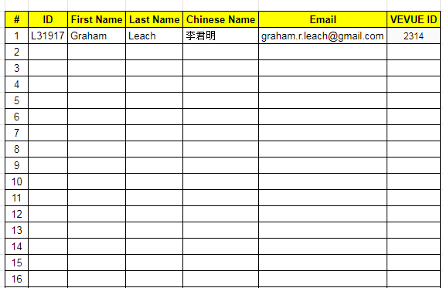
The Information VEVUE Needs

Slide 5
Questions?

Slide 6
Thank You

