Slide 1
SD5906 Globalization in New Media Design and Technology
ARCHETYPES
School of Design
The Polytechnic University of Hong Kong

Slide 2
IMPORTANT
Please sit with the members
of your final group project

Slide 3
What is an Archetype?
It is an instinctive behaviour that “naturally” resolves an emergent unresolved situation.
It is a mental tool we can use to model and validate the past, present and future.
It is a social form that helps to keep the peace and guides us towards more useful, more productive lives.

Slide 4
Where To Find Archetypes?
Archetypes are all around us. They are us.
We use them to pre-program large portions of our waking day, so we can think about things.
Another way of finding archetypes is looking for low-resolution people who inhabit a role for us, rather than an identity. In fact, these people are more like tools to us than humans.

Slide 5
Why Care About Archetypes?
Archetypes used to be the only way that we were able to program our daily actions, because we had no other option available.
With the Enlightenment, radical new tools for operating in “reality” became available to us.
These new tools include Rational Analysis, Logic and the Scientific Method.

Slide 6
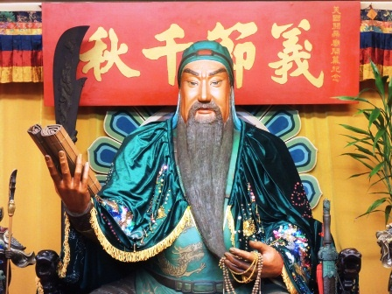
A Chinese Archetype

Slide 7
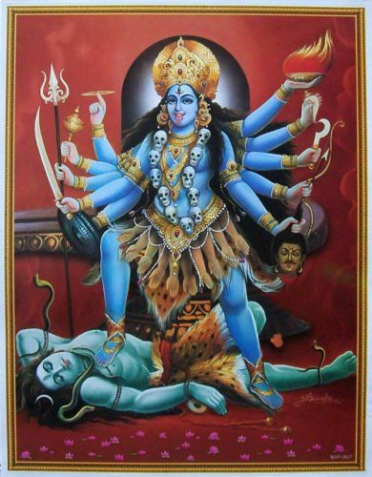
A Hindu Archetype

Slide 8
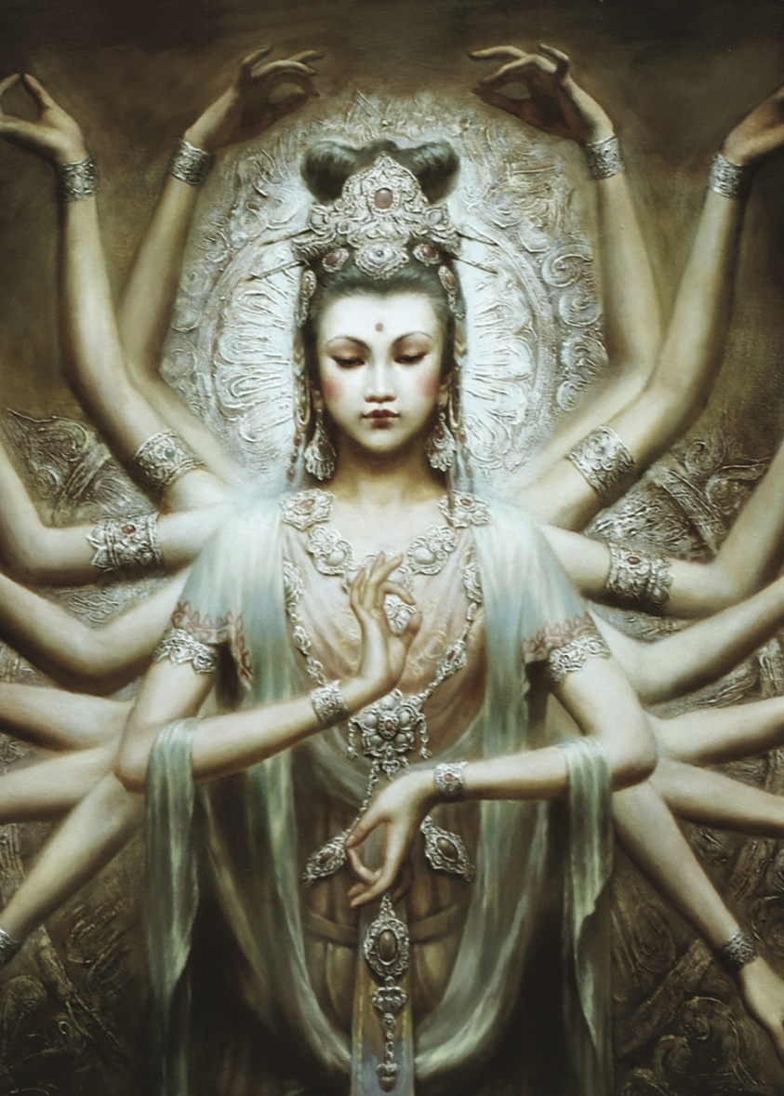
A Buddhist Archetype

Slide 9
A Christian Archetype

Slide 10
The Essence of Archetypes
Archetypes are personified expressions of the highest order of common human behaviours.
While they are presented as personifications, they are not externalize - they are us.
Their packaging as gods just makes them more relatable, and to remind us that we frequently operate in the mode of the divine.

Slide 11
Questions?

Slide 12
Thank You

