Slide 1
SD5906 Globalization How People Connect Through Symbols
School of Design
The Polytechnic University of Hong Kong

Slide 2
Format of Today’s Presentation
Psycology of Symbols
Symbols - Origin & definitions
Symbols - Language
Symbols - Transformative opportunity?

Slide 3
Psychology of Symbols
Embodied Action (least abstract)
Tool Making & Using (abstract)
Symbolic Manipulation (most abstract)

Slide 4
Psychology of Symbols
“Things that stand for actual things” - Signs
“Things that stand for metaphysical concepts”- Symbols
- Carl Jung

Slide 5
Language: Symbolism v/s Metaphor
‘I am throwing a towel’
‘Add oil’

Slide 6
Symbols - origins
Greek σύμβολον symbolon
"token, watchword"
“Something which stands for something else"

Slide 7
Definitions
A symbol is an energy evoking, and directing, agent.
- Joseph Campbell ( The Symbol without meaning)

Slide 8
Definitions
"Concepts and words are symbols, just as visions, rituals, and images are; so too are the manners and customs of daily life. Through all of these a transcendent reality is mirrored. There are so many metaphors reflecting and implying something which, though thus variously expressed, is ineffable, though thus rendered multiform, remains inscrutable. Symbols hold the mind to truth but are not themselves the truth, hence it is delusory to borrow them. Each civilization, every age, must bring forth its own.
- Heinrich Zimmer

Slide 9
Definitions
A symbol ... is a visual image or sign representing an idea -- a deeper indicator of a universal truth
- book ’Signs and Symbols’

Slide 10
Pictographic Symbol as Language (From early languages to Emojis)

Slide 11


Chinese language - Symbolic?

Slide 12
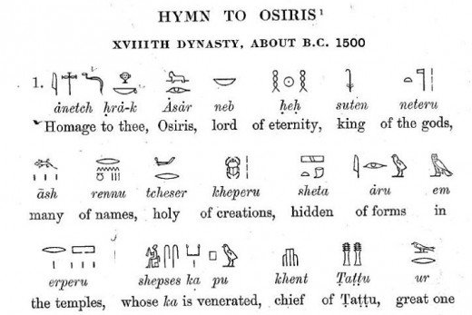
Egyptian Language
http://anylanguageatall411.blogspot.com/2015/04/first-lessons-in-egyptian-hieroglyphic.html

Slide 13
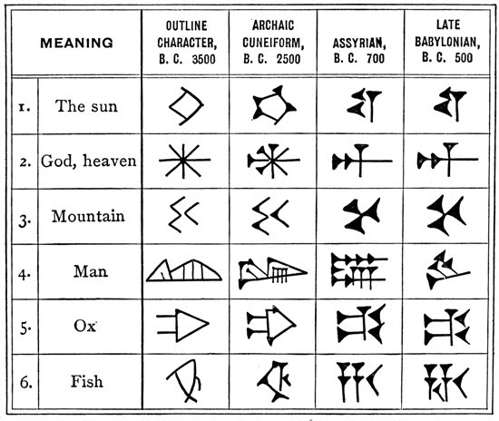
Mesopotamia Language
https://sites.google.com/site/mesopotamiantravelagency/what-to-expect/language

Slide 14
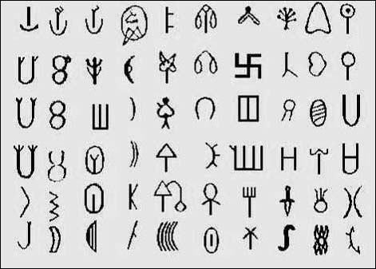
Indus Valley language
http://www.crystalinks.com/indus.html

Slide 15
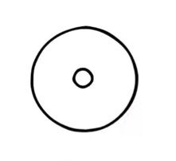
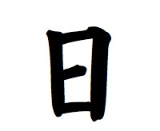
Different symbols - challenges?
Mesopotamia
Egypt
China

Slide 16
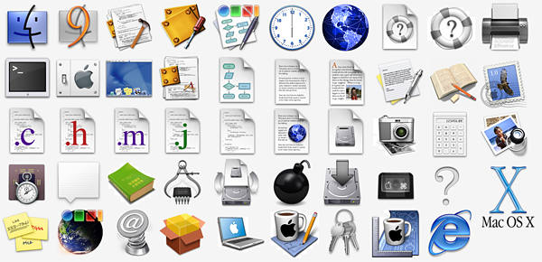
Current & Future use
https://www.interaction-design.org/literature/article/a-brief-history-of-the-origin-of-the-computer-icon

Slide 17
Signs v/s Symbols
A sign points to something we already know.
A symbol, however, points to something unknown and mysterious, and is often the precursor to a transformation.
- C.G. Jung (Analytical psychology, )

Slide 18
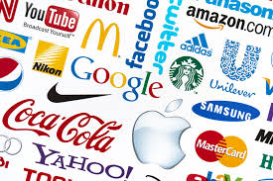
Signs
https://legallogik.com/brands-vs-trademarks/

Slide 19
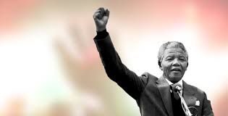
Symbols
www.madeladay.com

Slide 20
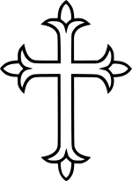
Sign or symbol?
Atheist - a sign for church
Christians - symbolic, pointing to God

Slide 21
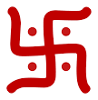
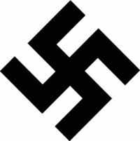
Sign or symbol?
Hindus - symbolic (divine, spirituality)
Non Hindus - Nazi emblem

Slide 22
Practical Implications
Image -> confirmation ( no development )
Image -> Meaning? Mystery?
Then the symbol may lead to a significant and valuable transformation spiritual awareness, personal growth and relationships

Slide 23
Questions?

Slide 24
Thank You

