Slide 1
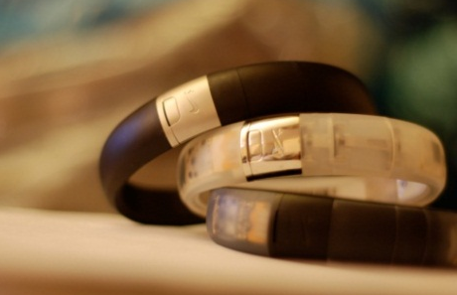
Chandan Sethi
20+ Years
Products : Ricoh, IBM, Nokia, Motorola, Blackberry, Sony, Amazon, Nike
Mechatronics Engineer, BA ( Sociology), MBA, (UNI), Negotiations (Harvard)

Slide 2
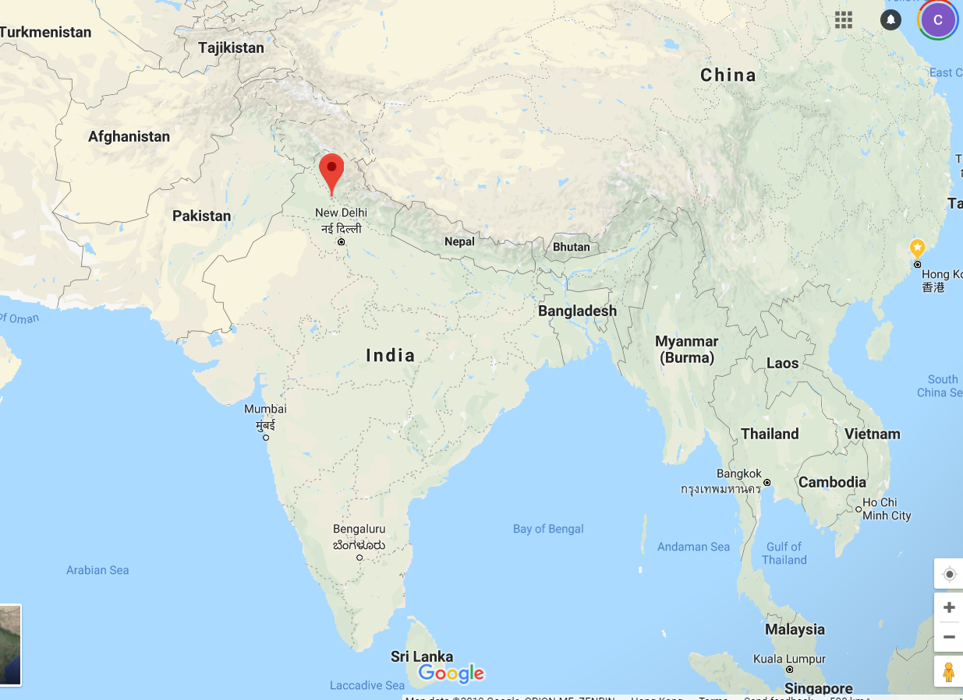
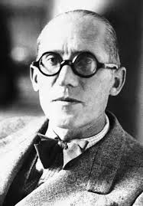
Hometown
Chandigarh, UT, India ( North of New Delhi)
City Beautiful – designed by Swiss French Architect Le Corbusier

Slide 3
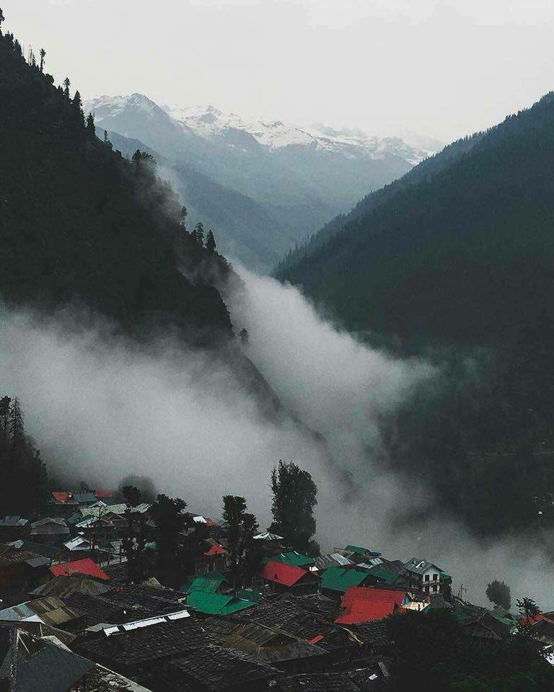
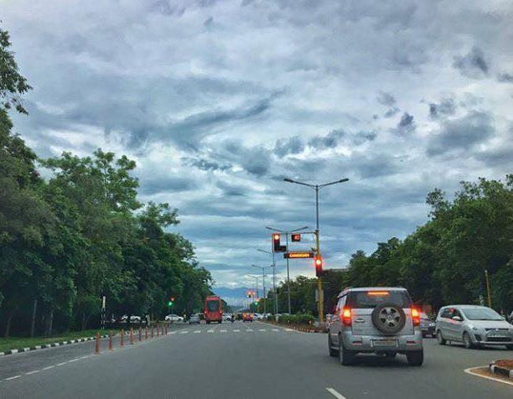
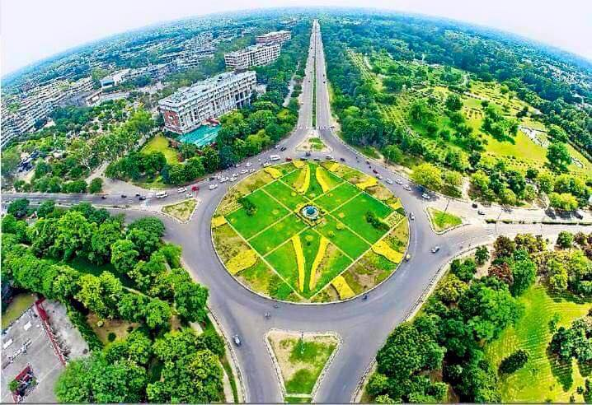
Chandigarh

Slide 4
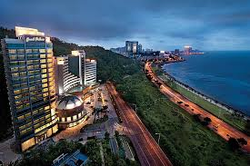
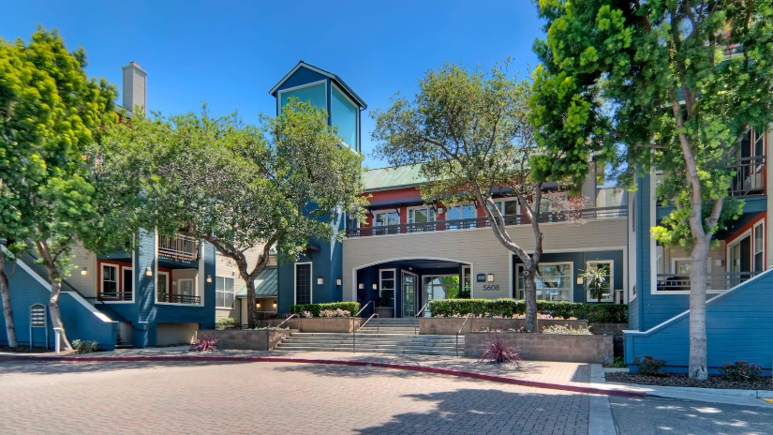
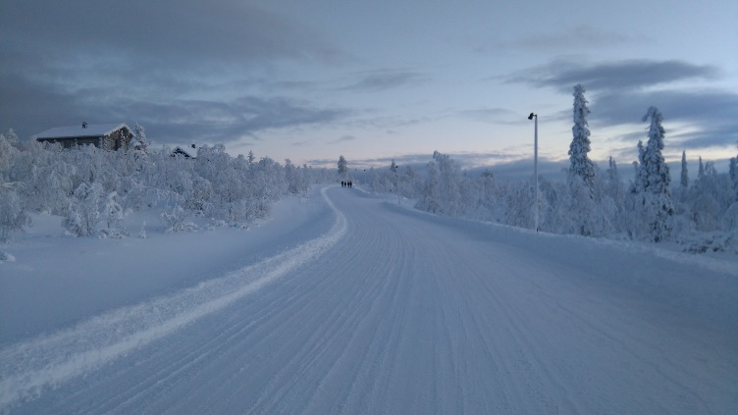
Global Citizen
20+ Years of work
Zhuhai, Hog Kong, Shenzhen, Suzhou, Tianjin, Seoul, Boston, Cupertino, Portland, Guangzhou, Chandigarh, Bangalore, Joensuu ( Finland), Darmstadt ( Germany)…….

Slide 5
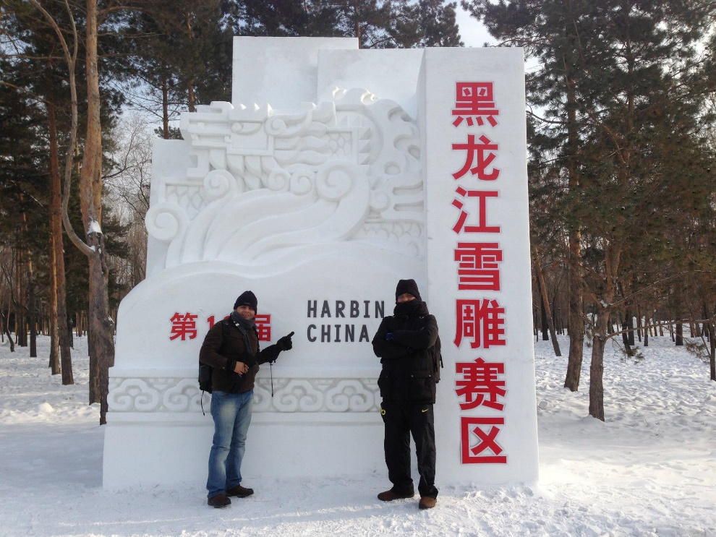
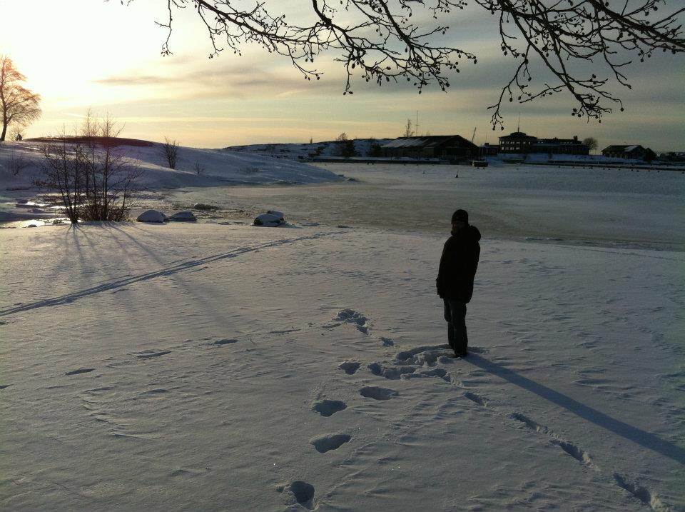
Global Citizen
And travelled a lot
Guilin, Yang shuo, Toronto, Beijing, Emei shan, Chengdu, Le shan, Shanghai, Huangshan,
Harbin, Paris, Maastricht, Paris, Amsterdam, Berlin, Mathura, Hangzhou…almost all of India..

Slide 6
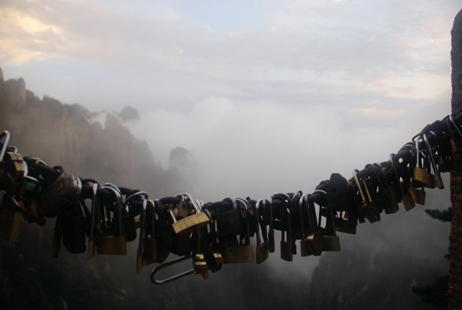
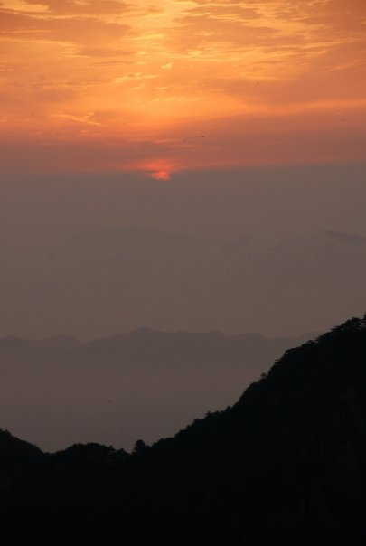

Slide 7
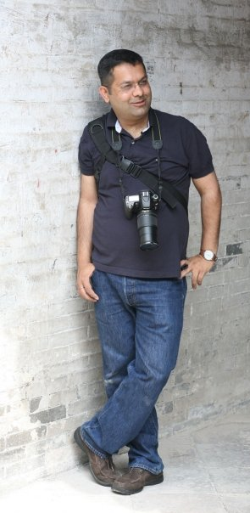
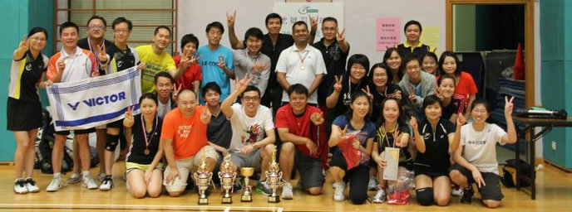
My hobbies..

Slide 8
Wearable Technology
From Fitness to Wellness & Healthcare

