Slide 1
SD5906
Globalization
COMMUNICATIONS
School of Design
The Polytechnic University of Hong Kong

Slide 2
IMPORTANT
Please sit with the members
of your final group project

Slide 3
Format of Today’s Presentation
We are going to examine a common COMMUNICATIONS MODEL
We are going to examine a common ORGANIZATIONAL MODEL
We are going to examine a common
INNOVATION MODEL

Slide 4
A Common
Communications Model

Slide 5
Bavelas & Leavitt
In 1950, Alex Bavelas and Harold Leavitt defined a small set of Communication Models that we still use today (https://bit.ly/2U22E9a)
In the experiment, people were asked to design information networks with 4 and 5 persons.
The resulting Communications Models were then documented and analyzed to help us understand their strengths & weaknesses, and also where they might be best applied to different situations.

Slide 6
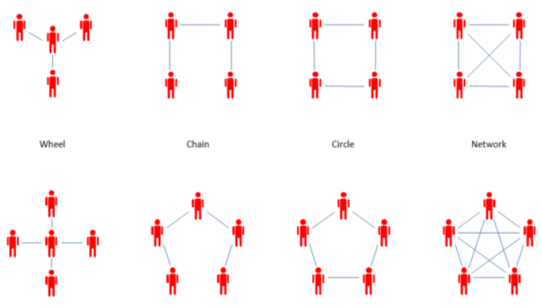
Leavitt’s Communication Models
https://managementmania.com/en/communication-patterns

Slide 7
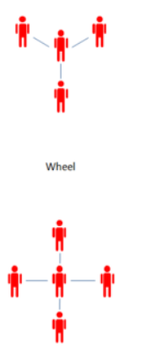
Wheel
In a wheel, all messages flow through one person at the centre.
What are the advantages of this model?
What are its disadvantages of this model?

Slide 8
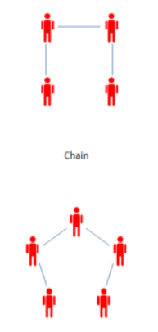
Chain
In a chain, information flows from one person to one or two others.
What are the advantages of this model?
What are its disadvantages of this model?

Slide 9
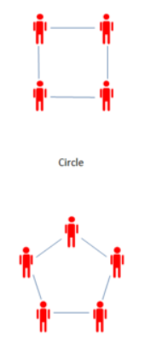
Circle
In a circle, information flows from one person to two other people.
What are the advantages of this model?
What are its disadvantages of this model?

Slide 10
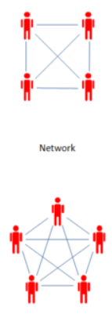
Network
In a network, information flows from one person to everyone else.
What are the advantages of this model?
What are its disadvantages of this model?

Slide 11
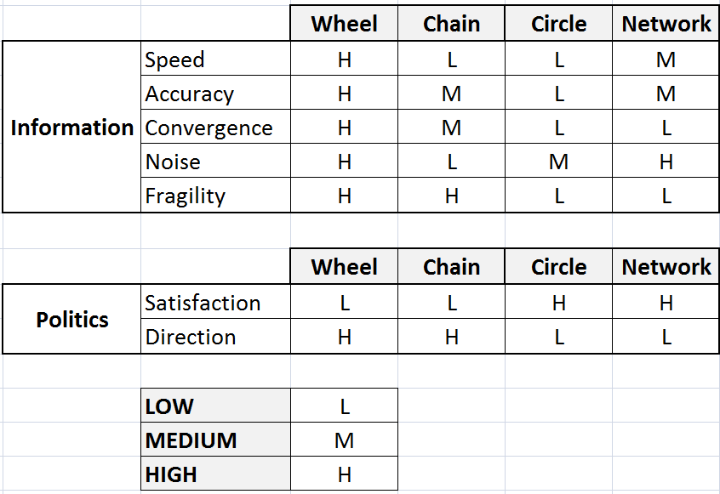
Leavitt’s Models – Summary of Features
https://www.slideshare.net/divyebokdia/communication-structure-in-a-group-divye-bokdia

Slide 12
A Common
Organizational Model

Slide 13
Kaplan & Norton
In 1992, Kaplan & Norton published an article in the Harvard Business Review explaining a powerful new idea: The Balanced Scorecard. The article (https://bit.ly/1VHTGso) was followed up with a book in 1996 (ISBN: 9780875846514).
The Balanced Scorecard puts into practice an old management axiom:
“You can’t improve what you don’t measure”.

Slide 14
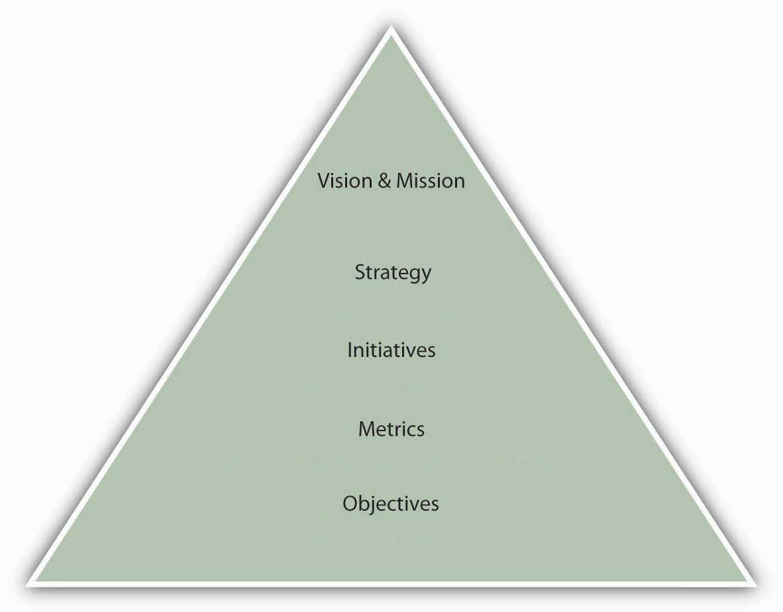
The Balanced Scorecard: Layers (Simplified)

Slide 15
Balanced Scorecard: Managing Uncertainty
RISKY
SAFE

Slide 16
Balanced Scorecard: Managing Organization
NO STRUCTURE
STRUCTURE

Slide 17
Balanced Scorecard: Managing Emergence
NO STRUCTURE
STRUCTURE
UNCLEAR
RISKY
SAFE
CLEAR

Slide 18
A Common
Innovation Model

Slide 19
Rogers
In 1962, Everett Rogers published a book about something he called the Diffusion of Innovations curve (https://amzn.to/2Kq1nof).
In the book, Rogers described how new ideas move from the fringe to the center of society, gaining more and more adoption as time passes.
The Diffusion of Innovation curve is actually an application of the Normal, Gaussian or Bell Curve.

Slide 20
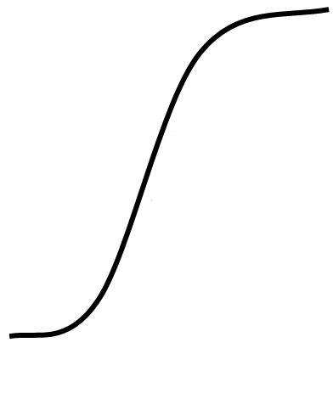
The Diffusion of Innovations Curve
Idea Maturity
Idea Development
Idea Infancy

Slide 21
To Apply It Here, We Must First Invert It
Radical Ideas
Entropy
Conventional Ideas
The new vision

Slide 22
Now, We Can Apply It
Inception
Integration
Continuity

Slide 23
What To Do When In: Inception
Opportunity Seeking
Problem Solving
Divergence
Creativity

Slide 24
What To Do When In: Integration
Analogies
Model Adaptation
Technology Adoption

Slide 25
What To Do When In: Continuity
Rationalization
Tweaking
Incrementalism

Slide 26
APPLICATION

Slide 27
So, Why Do We Have Organizations?
Organizations are basically problem-solving machines
Great Organizations break problems down into steps
Great Organizations execute along identified layers:
  Vision & Mission
  Strategy
  Initiatives
  Metrics
  Objectives

Slide 28
A Thought Experiment
Activity for Next Week:
Now that you know the Diffusion of Innovations Curve, The Balanced Scorecard and our Communication Models, how would you apply them to your FYP as it moves through a proposed 3 year lifespan, from Inception to Consolidation and then on towards Optimization?

Slide 29
Questions?

Slide 30
Thank You

