Slide 1
How We Are The Same.
And What this means for Business.

Slide 2
How global businesses take advantage of ‘sameness’
SD5906

Slide 3
POP QUIZ
Name the 5 qualities of a Business that would make it truly Global

Slide 4
Presence… across the globe
Consistency… across the globe
Clear value proposition… across the globe
Recognized… across the globe
Coherency vs. consistency… across the globe

Slide 5
QUESTIONS TO ASK
What do you standardize?
When do you standardize?
Why do you standardize?

Slide 6
THE TRADE OFF
Higher end
Cost
Lower end
Customisation
Standardization

Slide 7
THE BUSINESS VALUE
Luxury and high value
Margin
commodities
Value

Slide 8
How Same-ness Goes Global

Slide 9
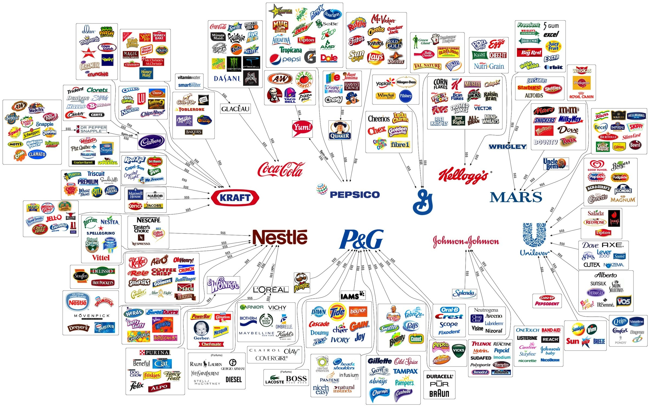
Food & Beverage

Slide 10
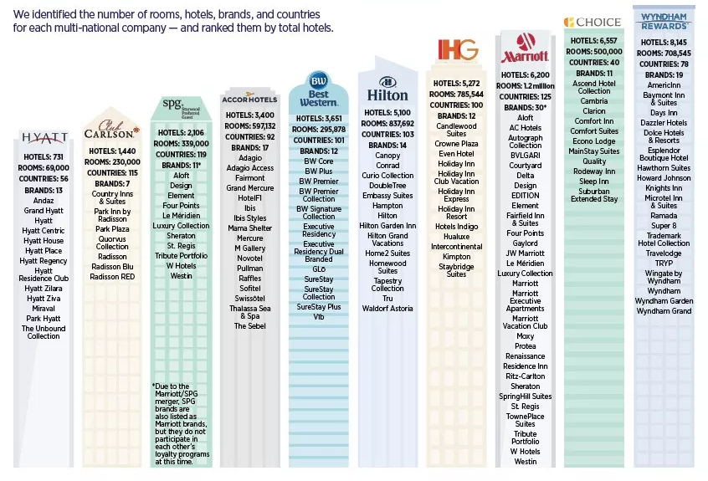
Hotels & Accommodation

Slide 11
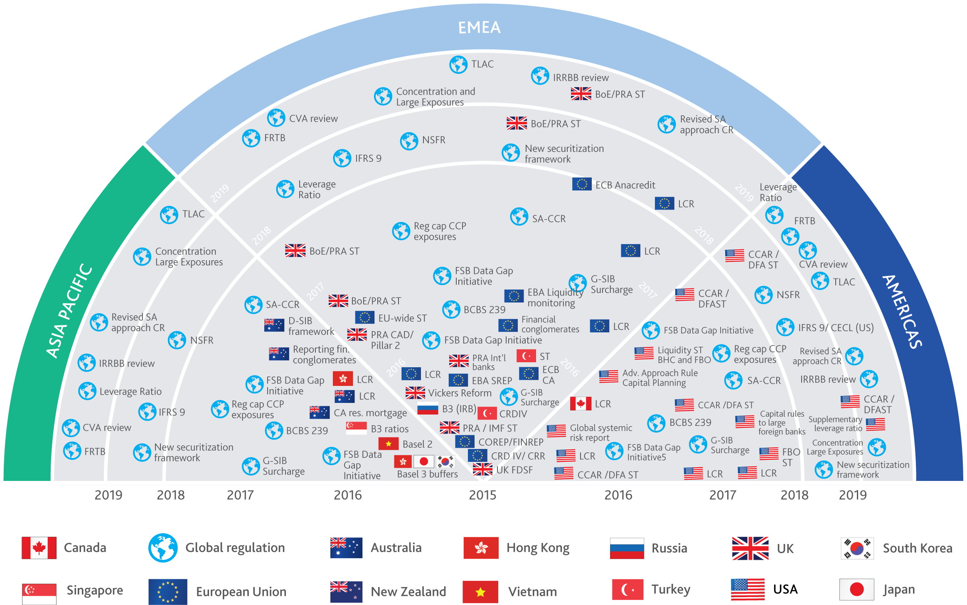
Banking & Regulation

Slide 12
Case: How Samsung changed

Slide 13
Old Samsung
New Samsung
Marketing fragmentation
Brand inconsistency
Cheap commodity
R&D-cost
Korean Manufacturing Company
Products standalone
OEM
Single brand agency
Single brand identity
High Quality products
R&D
Integration / Digital World
OBM

Slide 14
How Startups are doing it?

Slide 15
Process
Understand the Need / Problem
Develop and test a solution
Scale

Slide 16
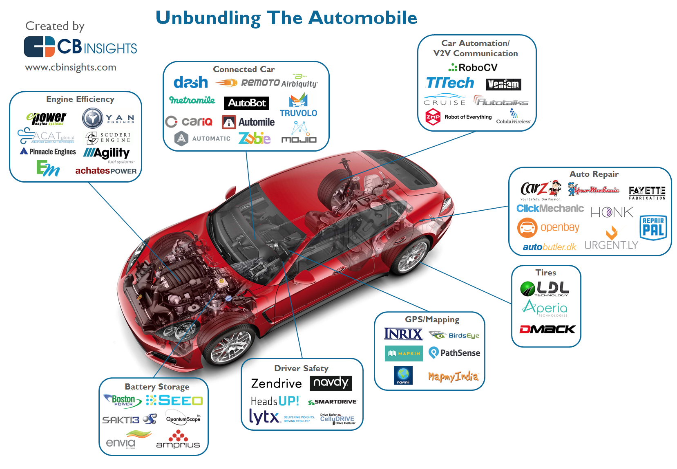
Intelligent Autos
“by 2020 we’ll have cars capable of being fully autonomous in certain circumstances, most likely rural interstates with minimal variables (and no inclement weather).”
source

Slide 17
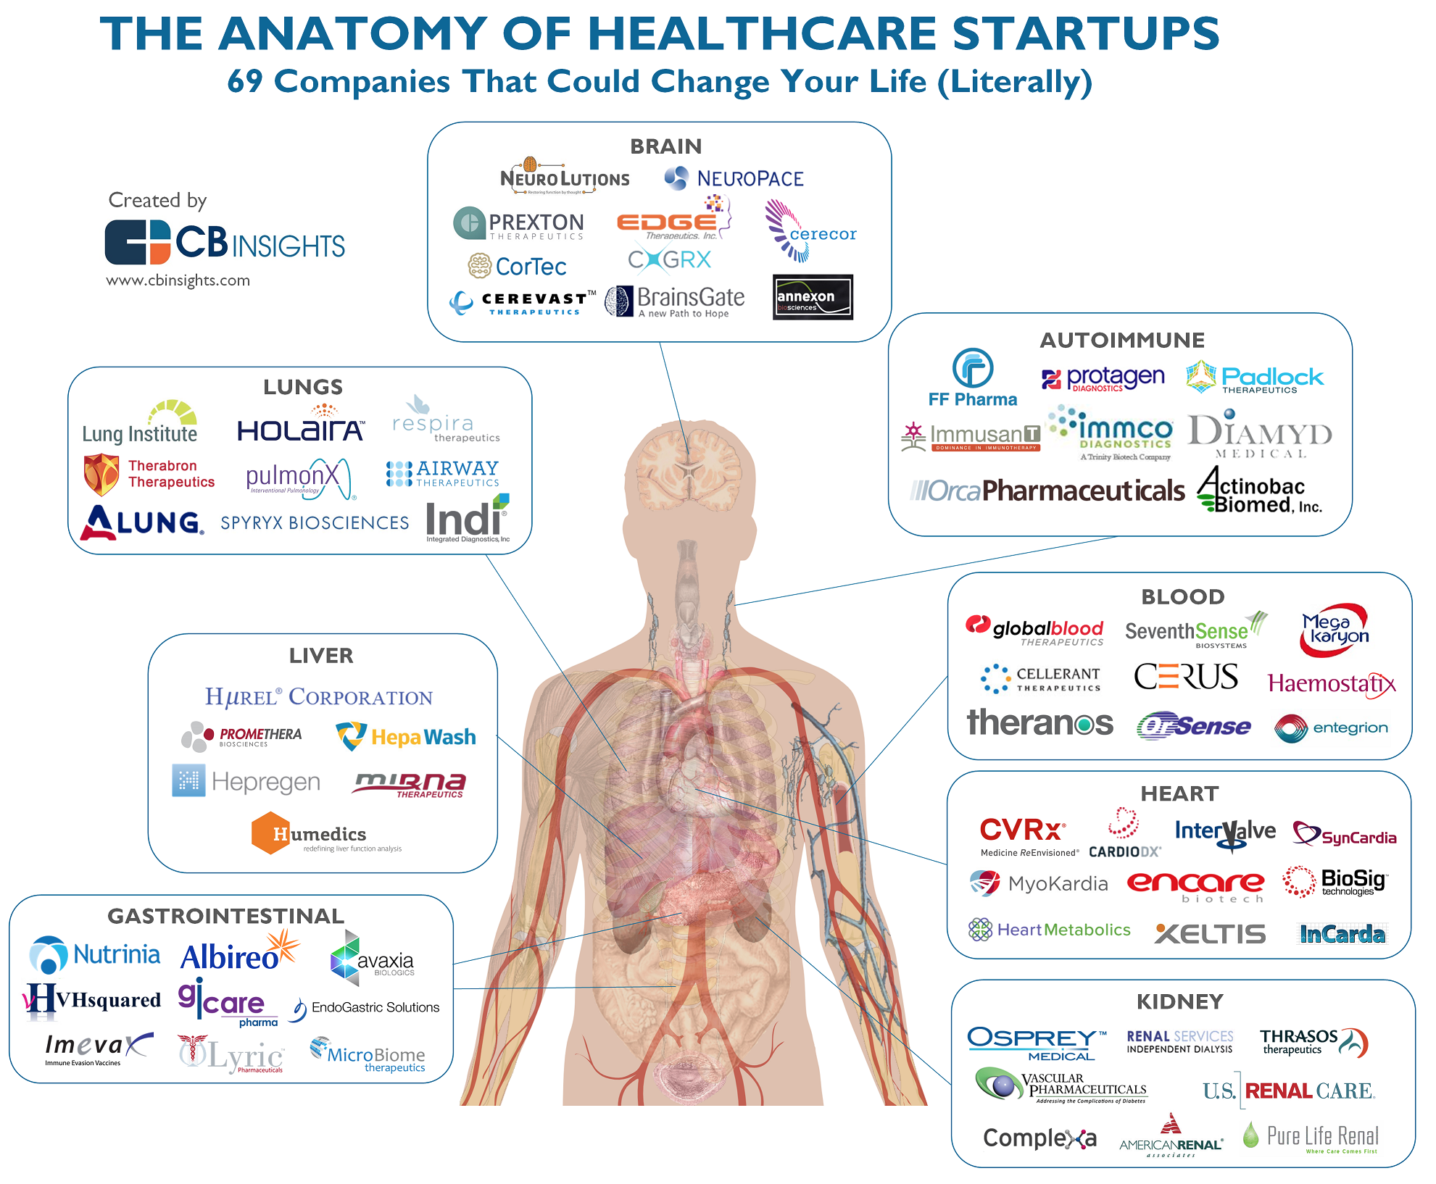
Healthcare
The X Prize Foundation, an innovation organization led by Dr. Peter Diamandis, is offering a $10 million award to the first team to deliver a working "tricorder,"” the handheld diagnostic device used by medical officers in Star Trek to detect diseases.
source:

Slide 18
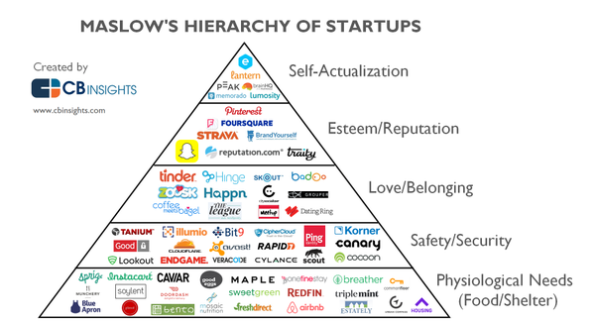
Emotion
"Most branded content will come from consumers.”
Source

Slide 19
You Must Understand ‘Desire’

Slide 20
Desire
Desire is a sense of longing or hoping for a person, object, or outcome. The same sense is expressed by emotions such as "craving". When a person desires something or someone, their sense of longing is excited by the enjoyment or the thought of the item or person, and they want to take actions to obtain their goal. The motivational aspect of desire has long been noted by philosophers; Thomas Hobbes (1588–1679) asserted that human desire is the fundamental motivation of all human action.
https://en.wikipedia.org/wiki/Desire

Slide 21
You Must Understand ‘Desire’
There will be one desire that your product or service will ‘speak to’ most powerfully. What is it?
8 Basic Human Desires
9 Learned Desires
Survival enjoyment of life life extension
Enjoyment of food and beverages
Freedom from fear pain and danger
Sexual companionship
Comfortable living conditions
To be superior winning keeping up with the Jones
Care and protection of loved ones
Social approval
To be informed
Curiosity
Cleanliness of body and surroundings
Efficiency
Convenience
Dependability / quality
Expression of beauty and style
Economy / profit
Bargains
Notes:
Nine learned desires:

Slide 22
Takeaways
Your Product or service will always trade off between Cost / customization.
Standardization is hard, but offers commercial advantages.
We share 8 basic human desires, and we have 9 learned desires.
Finding ways to offer personalization, while enabling standards is the magic sweet spot for any product or service.
Not every business is suitable for Globalization.

