Slide 1
SD5906
Globalization in
New Media Design and Technology
HOMOGENIZATION
School of Design
The Polytechnic University of Hong Kong

Slide 2
IMPORTANT
Please sit with the members
of your final group project

Slide 3
HOMOGENITY
This is a DARK Lecture

Slide 4

This is Natural Milk

Slide 5

This is Homogenized Milk

Slide 6
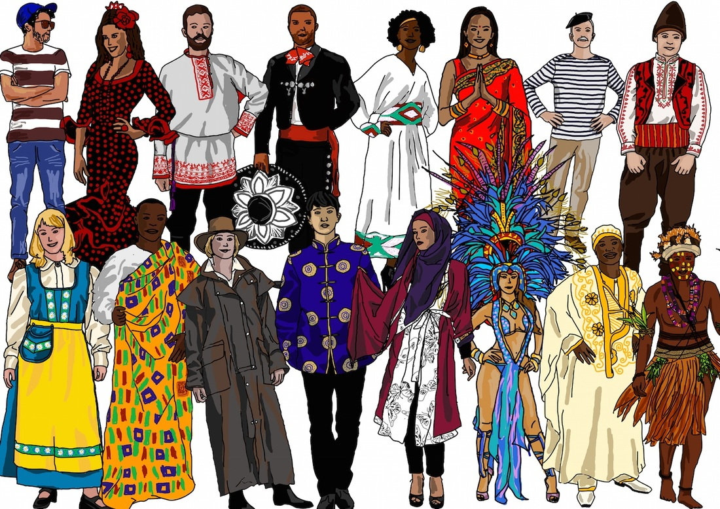
We Are So Different

Slide 7
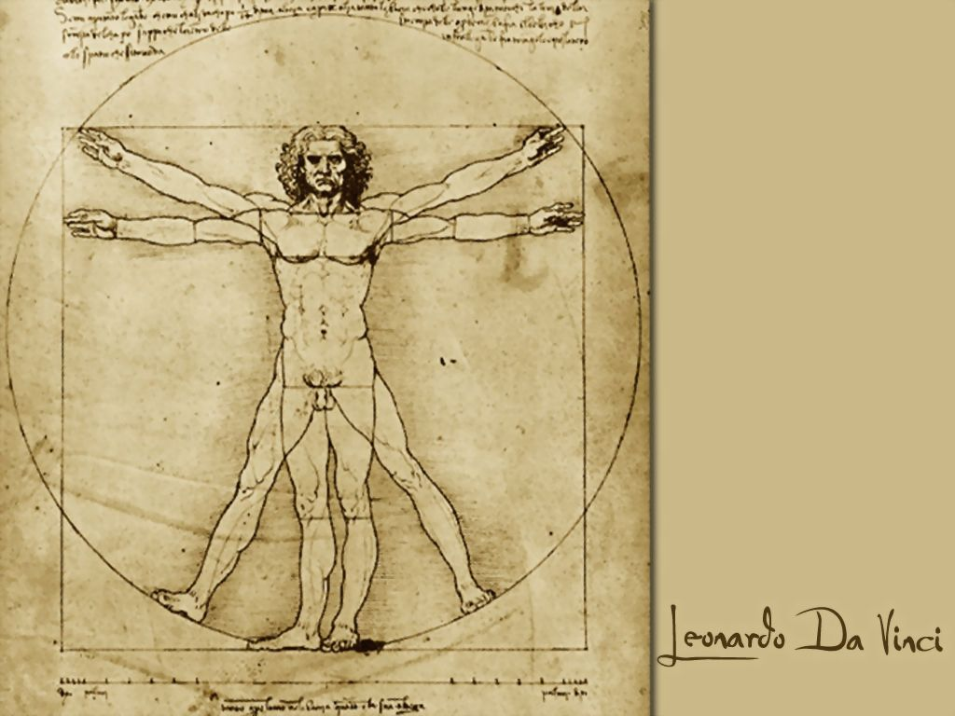
Yet We Are So Similar…Right?

Slide 8
WRONG
Let’s Look at Some Facts

Slide 9
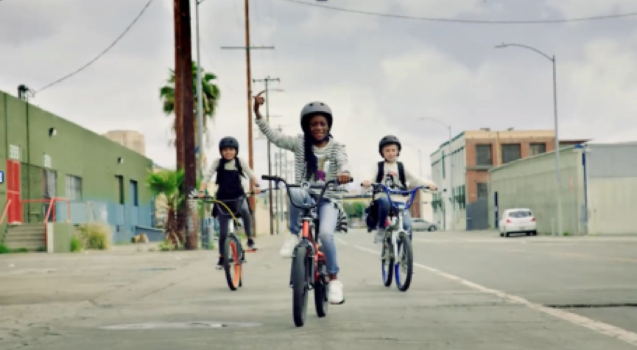
Is This Just a Nice Picture?

Slide 10
Or Is This Western Mind Control?

Slide 11
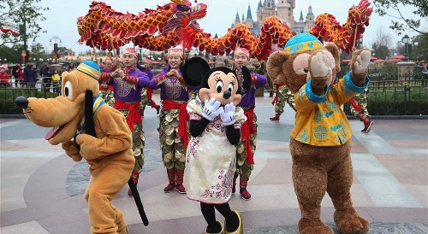
Or is THIS Western Mind Control?

Slide 12
THE WEST DOMINATES

Slide 13

Western Literature…

Slide 14
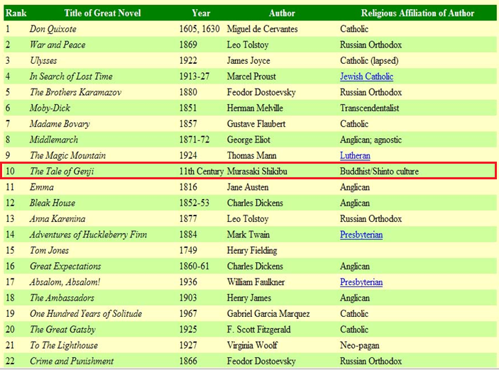
…Dominates

Slide 15

Western TV…

Slide 16

…Dominates

Slide 17

Western Film…

Slide 18
…Dominates
1. | Citizen Kane (1941)
2. | The Godfather (1972)
3. | Casablanca (1942)
4. | Raging Bull (1980)
5. | Singin' in the Rain (1952)
6. | Gone with the Wind (1939)
7. | Lawrence of Arabia (1962)
8. | Schindler's List (1993)
9. | Vertigo (1958)
10. | The Wizard of Oz (1939)

Slide 19

Western Music…

Slide 20

…Dominates

Slide 21
SOMETHING IS WRONG
Let’s Look at Other Facts

Slide 22
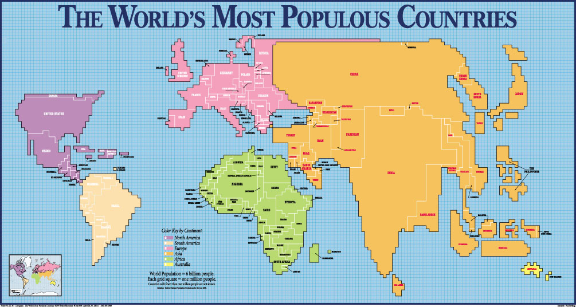
Here’s Where the People Are

Slide 23
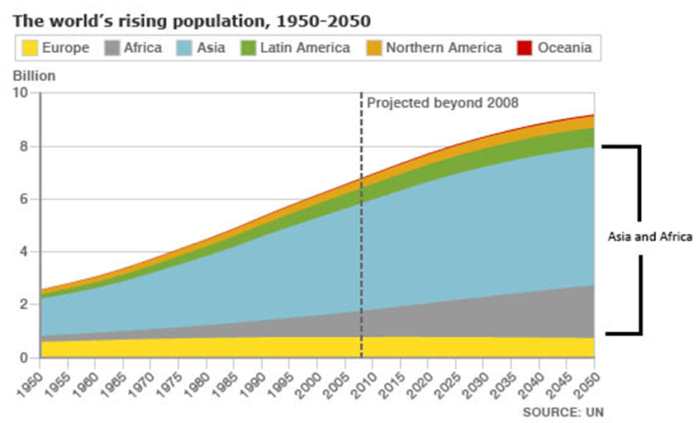
Here’s Where Things Are Going

Slide 24
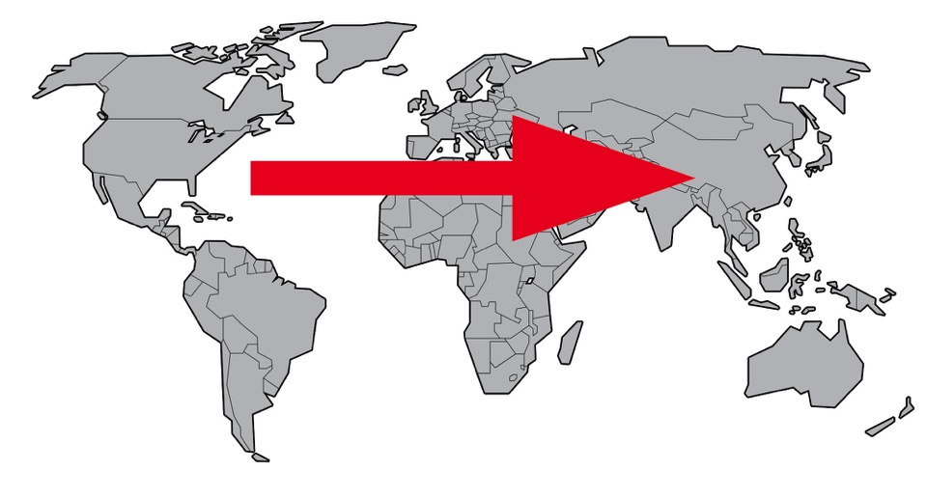
But Culture Is Flowing This Way…

Slide 25
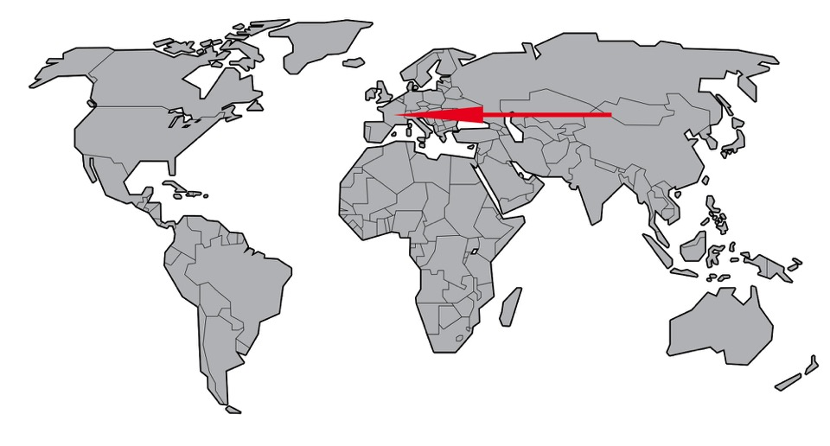
…Not This Way!

Slide 26

Yes, There is Some Flow…

Slide 27

But Not Enough!

Slide 28

Can You Explain Why?

Slide 29

We Need To Go From This…

Slide 30

STOP Doing This….

Slide 31

And START Doing This…

Slide 32
THE REST IS UP TO YOU

Slide 33
THANK YOU

