Slide 1
SD5906
Globalization in
New Media Design and Technology
Culture-Driven Negotiation Styles
School of Design
The Polytechnic University of Hong Kong

Slide 2
IMPORTANT
Please sit with the members
of your final group project

Slide 3
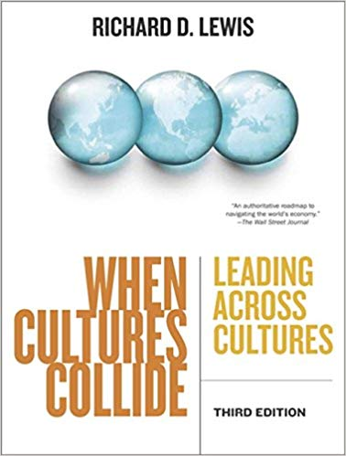
The Lewis Cultural Model
Richard D. Lewis was a very
well-traveled businessman
He visited 130+ countries
He worked in 20+ countries
His model summarizes his
perceptions of other cultures

Slide 4
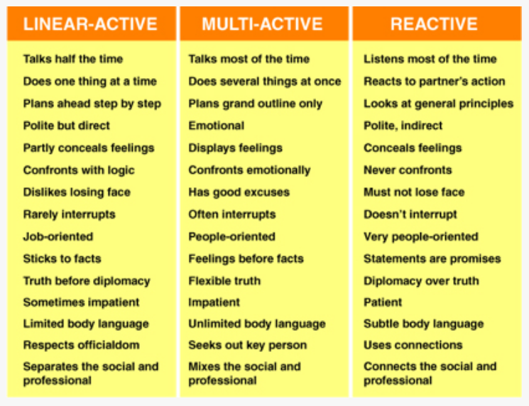
The Lewis Model: 3 Three Corners
https://www.crossculture.com/the-lewis-model-dimensions-of-behaviour

Slide 5
The Essence of the Types
Linear-Actives are task oriented and highly organized planners who complete action chains by doing one thing at a time, preferably in accordance with a linear agenda or plan.
Multi-Actives are emotional, loquacious and impulsive people who attach great importance to family, feelings, relationships, and people in general. They like to do many things at the same time and are poor followers of agendas.
Reactives are good listeners, who rarely initiate action or discussion, preferring first to listen to and establish the other’s position, then react to it and form their own opinion and position.

Slide 6
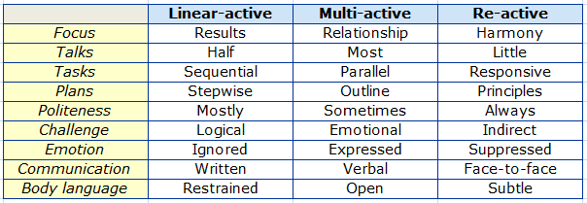
Summary of Points

Slide 7
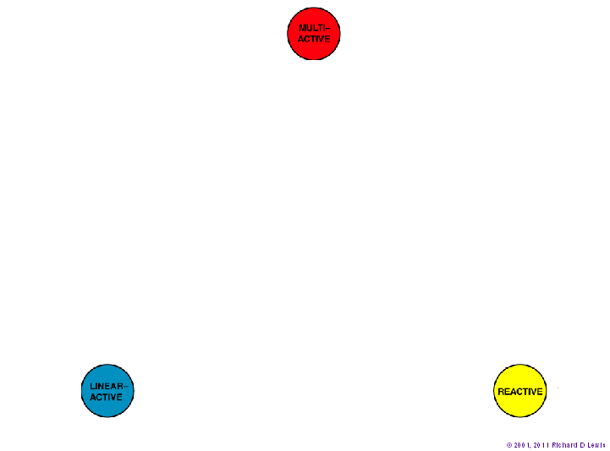
Where The Corners Are

Slide 8
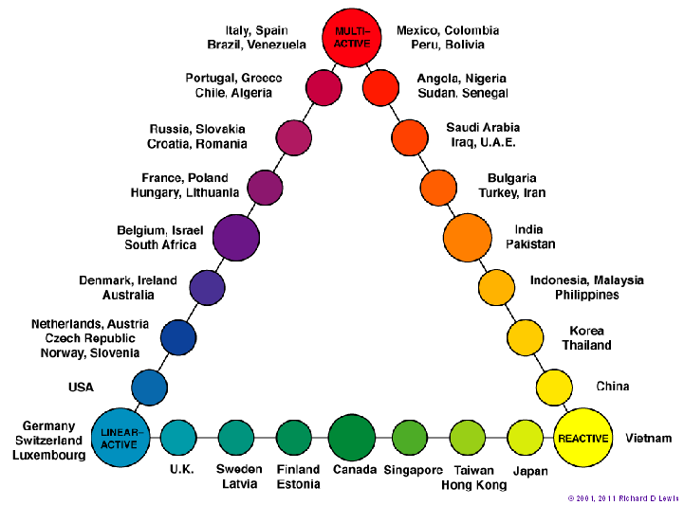
Where The Countries Sit

Slide 9
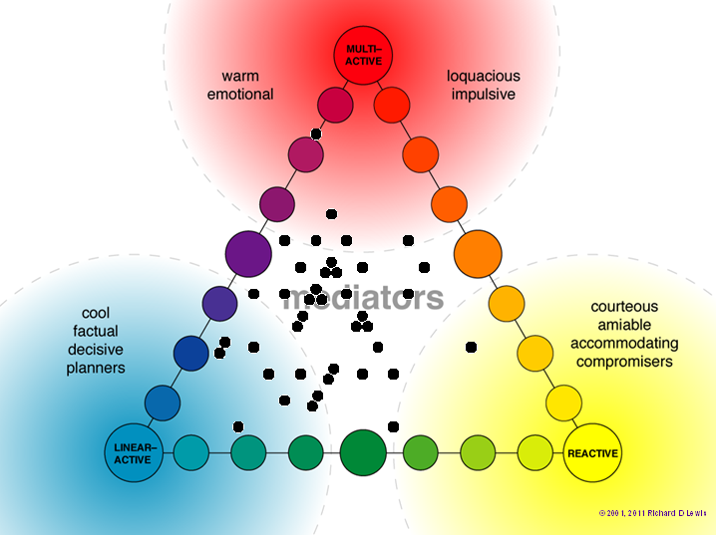
Where The Personalities Sit

Slide 10
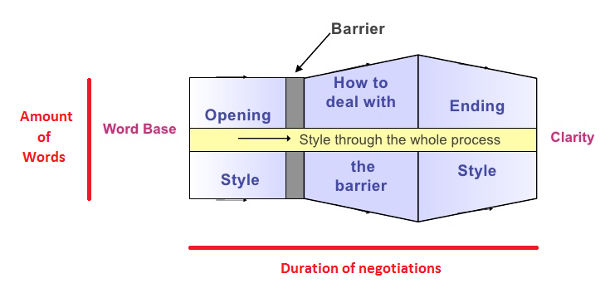
How To Use The Lewis Model
https://www.slideshare.net/sinauonline/leading-successfully-across-cultures

Slide 11
Country Models
How Very Different We Look!

Slide 12
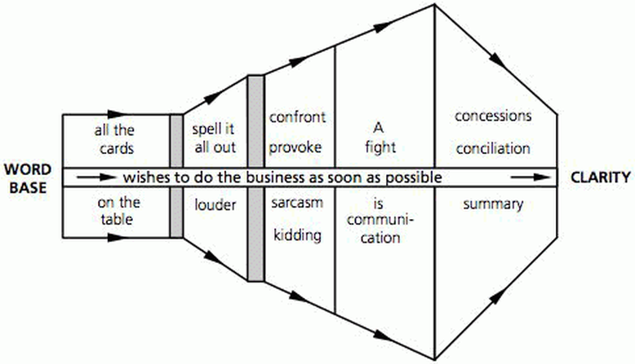
American
Americans lay their cards on the table and resolve disagreements quickly with one or both sides making concessions.

Slide 13
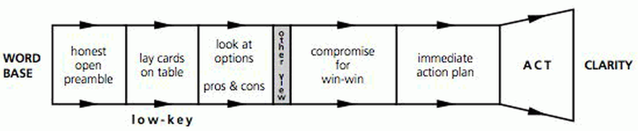
Canadian
Canadians are inclined to seek harmony but are similar to Americans in their directness.

Slide 14
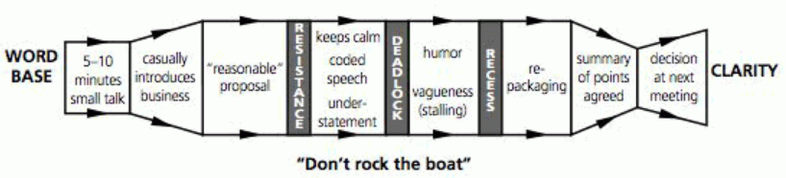
English
The English tend to avoid confrontation in an understated, mannered, and humorous style that can be either powerful or inefficient.

Slide 15
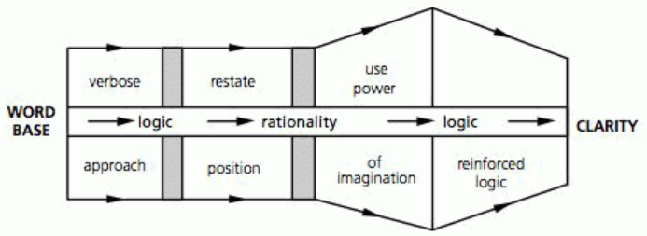
French
The French tend to be ready for a vigorous, logical debate.

Slide 16
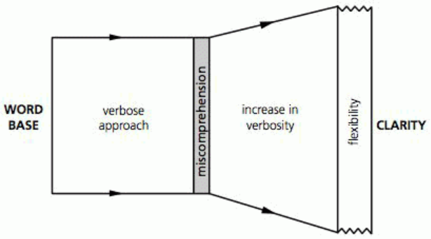
Italian
Italians regard their language as an instrument of eloquence and often take a verbose, flexible approach to negotiations.

Slide 17
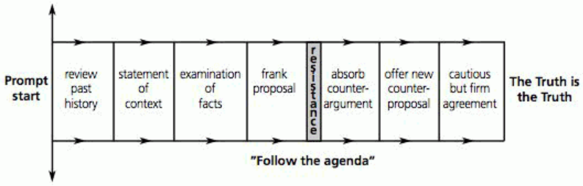
German
Germans rely on logic but tend to amass more evidence and belabor their points more than either the British or the French.

Slide 18
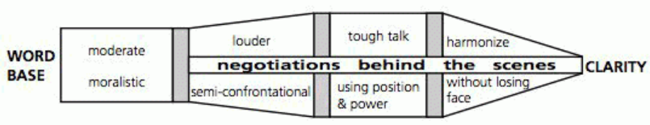
China
The Chinese tend to be more direct than the Japanese and some other East Asians. However, meetings are principally for information gathering, with the real decisions made elsewhere.

Slide 19
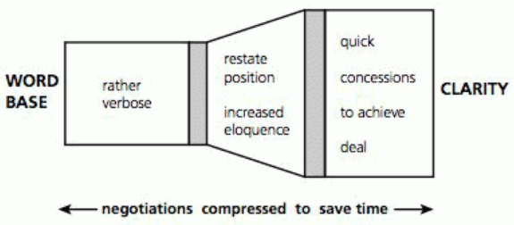
Hong Kong
People in Hong Kong negotiate much more briskly to achieve quick results

Slide 20
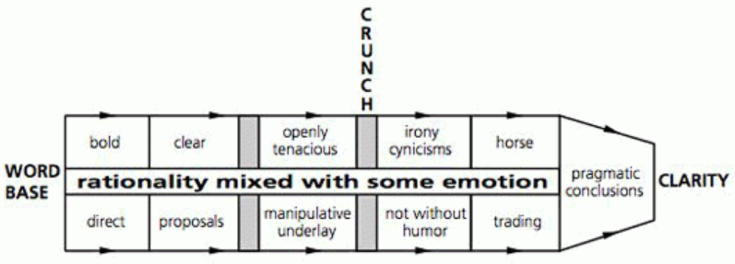
Israeli
Israelis tend to proceed logically on most issues but emotionally on some.

Slide 21
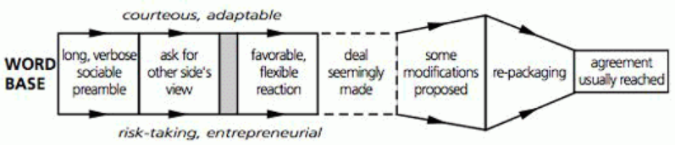
Indian
The Indians excel in ambiguity, and things such as truth and appearances are often subject to negotiation.

Slide 22
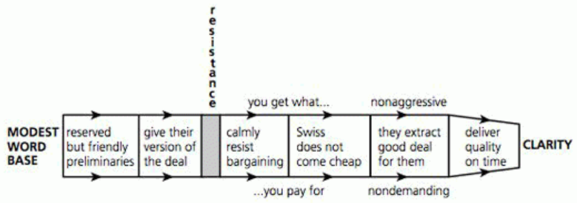
Swiss
The Swiss tend to be straightforward, nonaggressive negotiators. They obtain concessions by expressing confidence in the quality and value of their goods and services.

Slide 23
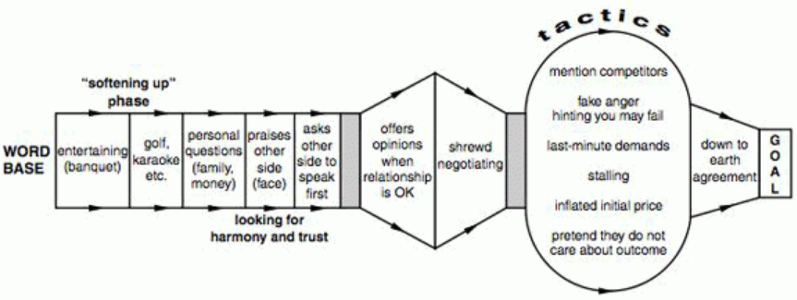
Singaporean
Singaporeans generally take time to build a relationship, after which they can be shrewd negotiators.

Slide 24
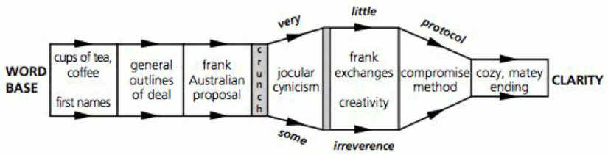
Australian
Australians tend to have a loose and frank style.

Slide 25
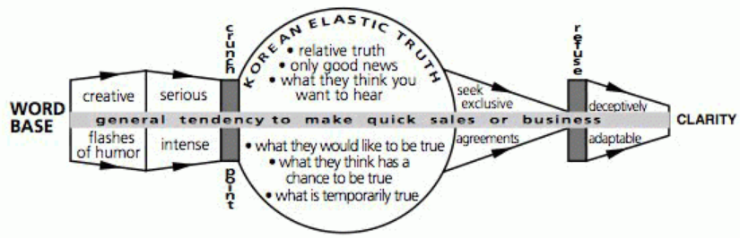
Korean
Koreans tend to be energetic conversationalists who seek to close deals quickly, but who also occasionally stretch the truth.

Slide 26
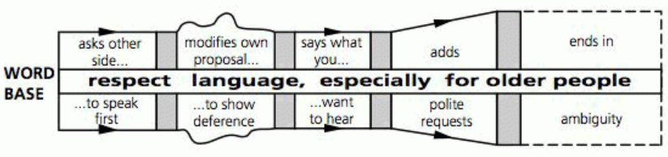
Indonesian
Indonesians tend to be deferential conversationalists, sometimes to the point of ambiguity.

Slide 27
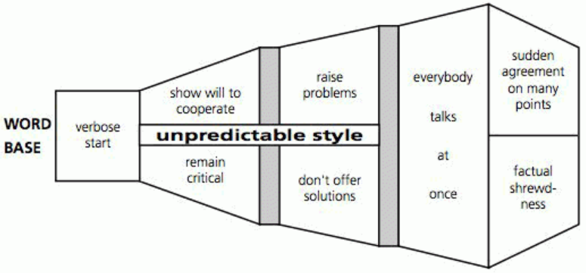
Hungarian
Hungarians value eloquence over logic and they are unafraid to talk over each other.

Slide 28
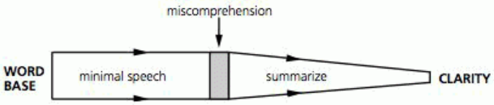
Finnish
Finns value concise compactness

Slide 29
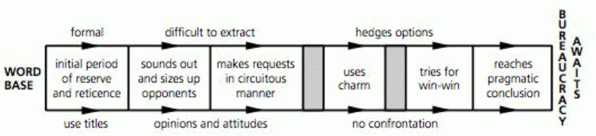
Bulgarian
Bulgarians may take a circuitous approach to negotiations before seeking a mutually beneficial resolution, which will often get screwed up by 3rd parties, like bureaucracy.

Slide 30
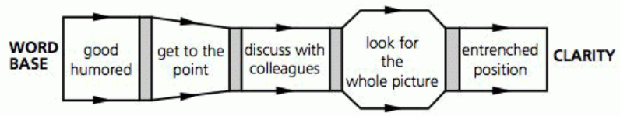
Norwegian
Norwegians fall somewhere in between Swedes and Finns. Finns value concise compactness, and Swedes enjoy wide-ranging discussions.

Slide 31
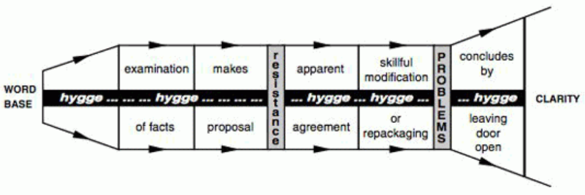
Danish
Norwegians fall somewhere in between Swedes and Finns. Finns value concise compactness, and Swedes enjoy wide-ranging discussions.

Slide 32
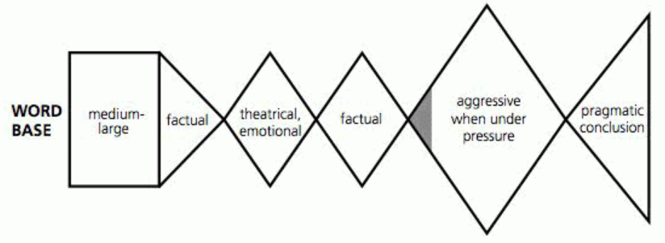
Polish
Poles often have an enigmatic communication style. It can vary from a matter-of-fact and pragmatic style to a wordy, sentimental, romantic approach.

Slide 33
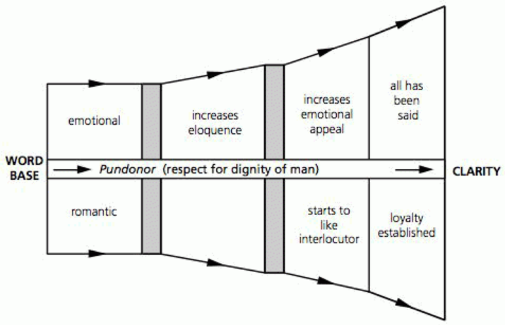
Spanish
When given the choice, Spaniards opt for maximum linguistic expressiveness.

Slide 34
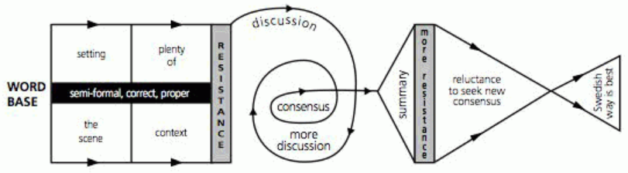
Swedish
Among the Nordic countries, Swedes are the most prone to have wide-ranging discussions.

Slide 35
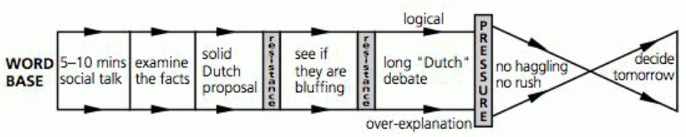
Dutch
The Dutch are focused on facts and figures but are also great talkers. They rarely make final decisions without a long debate that sometimes flirts with over-analysis.

Slide 36
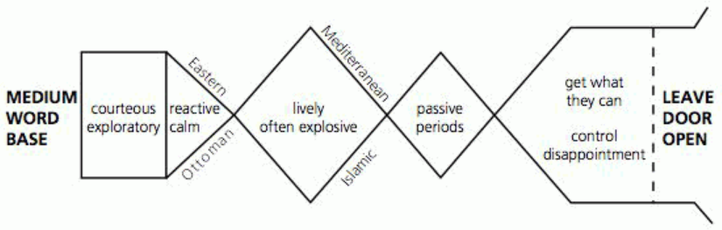
Turkish
The Turks can be skeptical, but generally think the best of people and they are rarely unreasonable unless they feel that they are being cheated.

Slide 37
Questions?
Discussion

Slide 38
AND NOW….
The Closing Game!

