Slide 1
SD5906
Globalization in New Media Design and Technology
Introduction – Graham Leach
School of Design
The Polytechnic University of Hong Kong

Slide 2
IMPORTANT
Please sit with the members
of your final group project

Slide 3
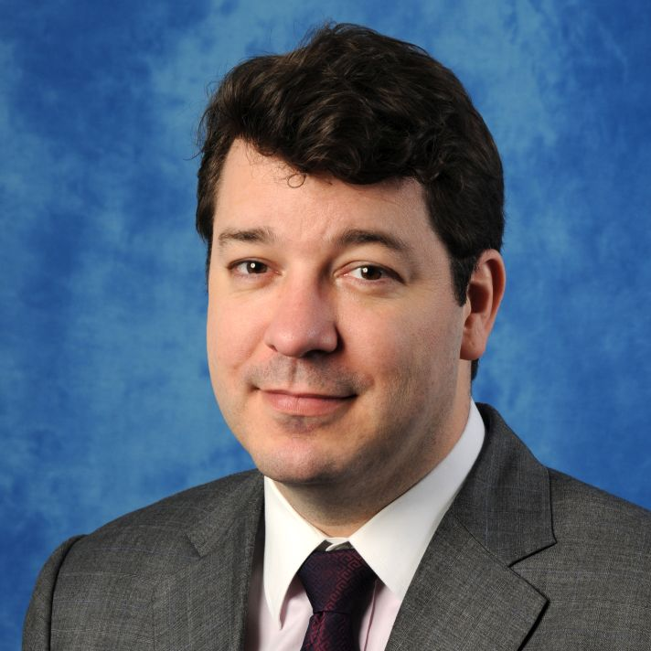


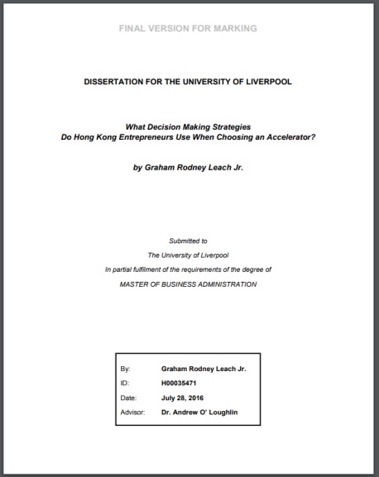


Experience:
Graham Leach - Accomplishments
Major Publications:
ASEC
AstenJohnson
Bayer
Caldera
Compelite
Decisionomics
Different Products
Difuon
Human Potential
Key-In Data Solutions
Manpower
Microsoft
Neureal
Purple Squirrel
SingularityNet
Talent2
Team Building Asia
YouGrow
Graham Leach,
MBA
Academic Achievements:
B.A., Concordia University, History & Computer Science
MBA, University of British Columbia, Strategic Management
MBA, University of Liverpool, Innovation & Entrepreneurship
Website
Professional Qualifications:
Microsoft Certified Systems Engineer
Microsoft Certified Professional
Microsoft Certified Trainer
Blog

Slide 4

Graham Leach - Contact
Name: Mr. Graham Leach, MBA
Title: Visiting Lecturer, HKPOLYU
Email: Professor@graham-leach.com
Mobile: +852 6977 9076
Telegram: @GrahamLeach
Whatsapp: +1 852 6977 9076
Twitter: @graham_leach
WeChat: ProfessorGrahamLeach
Skype: graham_leach
Website: www.graham-leach.com

Slide 5
Questions?

Slide 6
Thank You

